Slide 1

County’s Community Health Improvement Plan
Co-brand with your logo here
Notes:
Welcome to our county’s community health improvement plan!
You can make this branded just to your agency if your prefer.

Slide 2
What is a Community Health Improvement Plan (CHIP)?
A strategic health improvement plan for the entire community
Priority health issues identified through the CHA process
The results, indicators and strategies and/or programs for each health issue.
A product that captures the items identified through the collaborative action planning process in each county
Helps encourage cross-sector collaboration
Notes:
A Community Health Improvement Plan, or CHIP, is a long-term strategic health improvement plan for the entire community.

Slide 3
How did We Get Here?
Bullet out high level steps that got you to this point, i.e.:
Data collection
Prioritization
Community Health Assessment
Formed workgroups
Developed strategies
Notes:
Consider including a timeline or bullets that remind your audience of what the process has looked like up to this point.

Slide 4


Community Health Improvement Process
Collect & Analyze Community Data
Decide What is Most Important to Act On
Phase 3 Oct. 2019 – Dec. 2020
Phase 1 Jan. 2018 – Mar. 2019
Continuous Action & Ongoing Evaluation
Take Action & Evaluate Health Improvement
Community Health Strategic Planning
Community Health Improvement Plan (CHIP)
Phase 2 Apr. 2019 – Sep. 2019
Notes:
A CHIP addresses the priority health issues that were identified through the community health assessment process.
It also outlines the results, population health data, strategies, and programs or strategies associated with each health issue.

Slide 5
Why Scorecard for CHIP?
Easy-to-use, low cost, data tracking and display tool
Helps organize community health improvement efforts and tell the story behind the data
Real time and interactive
Easy to connect & share
You could include a screenshot of your CHIP here, along with the link.
Notes:
We use an online Scorecard format to share real-time information with community members, partners, leaders, and funders about how we are working together to improve the health of our community.

Slide 6
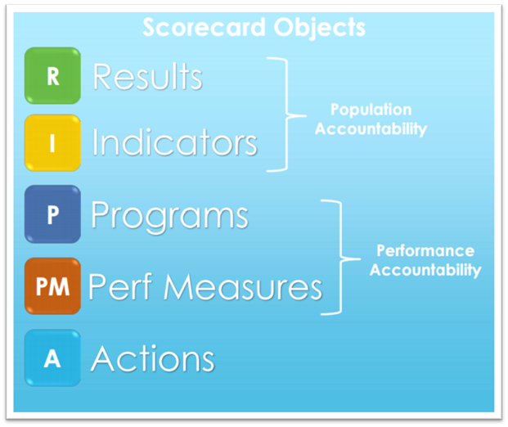
CHIP Scorecard Sections
Notes:
The CHIP Scorecard is made up of different objects such as the Results, Indicators, Strategies, and Performance Measures.
We’ll look at each of these in more detail.

Slide 7
Our Community’s Priority Health Issues
List priorities here
Notes:
This is the big picture view before we go into more detail around each health priority.

Slide 8





Priority 1: List the Priority Here
R
E
S
U
L
T
[Name of One of Your Results Here]
INDICATORS
List indicator here
List indicator here
List indicator here
STRATEGY
Name a program/ strategy here |  | Name a second program/ strategy here |  | Name a third program/ strategy here |  | P R O G R A M S
PERFORMANCE MEASURES
How much did we do? | How well did we do it? | How much did we do? | How well did we do it? | How much did we do? | How well did we do it?
Is anyone better off? |  | Is anyone better off? |  | Is anyone better off?
Notes:
Each priority health issue has a community Result – the green R.
A community result uses words everyone understands to describe well-being for an entire community in a defined geographical area or a specific subgroup
The Result may include: - How this health issue and the result are aligned with state-wide focus areas and objectives. - How we experience this result in our community and what information led to the selection of this health issue and related result.
This is to make an infographic for each of your results.
You can hyperlink each item to the relevant section in your Scorecard if you choose to do so.
You can take a screenshot of this graphic and use in various presentations/ handouts.

Slide 9
Priority Issue 1: Indicators
List headline indicators
Insert image of indicator chart here

Slide 10
Priority Issue 1: Programs or Strategies
List strategies/ programs here
Picture to illustrate strategy or program

Slide 11
Priority 2: List the Priority Here
R
E
S
U
L
T
[Name of One of Your Results Here]
INDICATORS
List indicator here
List indicator here
List indicator here
STRATEGY
Name a program/ strategy here |  | Name a second program/ strategy here |  | Name a third program/ strategy here |  | P R O G R A M S
PERFORMANCE MEASURES
How much did we do? | How well did we do it? | How much did we do? | How well did we do it? | How much did we do? | How well did we do it?
Is anyone better off? |  | Is anyone better off? |  | Is anyone better off?
Notes:
Each priority health issue has a community Result – the green R.
A community result uses words everyone understands to describe well-being for an entire community in a defined geographical area or a specific subgroup
The Result may include: - How this health issue and the result are aligned with state-wide focus areas and objectives. - How we experience this result in our community and what information led to the selection of this health issue and related result.
This is to make an infographic for each of your results.
You can hyperlink each item to the relevant section in your Scorecard if you choose to do so.
You can take a screenshot of this graphic and use in various presentations/ handouts.

Slide 12
Priority Issue 2: Indicators
List headline indicators
Insert image of indicator chart here

Slide 13
Priority Issue 2: Programs or Strategies
List strategies/ programs here
Picture to illustrate strategy or program

Slide 14
Get Involved!
Thank you message and/or call to action
Notes:
You could include the link to the full CHIP Scorecard here.

