Slide 1

Making Sense of Story Data
Follow-up from Listening Session Training

Slide 2
Welcome
Housekeeping
Packet orientation
Introductions
Results for the day
Notes:
EB

Slide 3
Results We Have in Mind for Today
Reflect on listening session experiences
Learn a concrete, hands-on method for making sense of story data
Practice turning actual story data into clusters and themes to identify insights from the data
Identify multiple uses for the practiced technique, in addition to making sense of listening session data
Discuss methods and opportunities for sharing insights gained from story data
Notes:
EB
Reflect on results we got, in advance from people via email
Reflect on results we got

Slide 4

Presenter Introductions
Erin Braasch, MPH, RN
Program Manager & Improvement Specialist
Erin.Braasch@wnchn.org
Rebecca Reeve, PhD. CHES
Independent Consultant
rreeve@unca.edu
Adrienne Ammerman, MA
Communications & Improvement Specialist
Adrienne.Ammerman@wnchn.org
Notes:
EB start intro w/ ice breaker
RR scribe and last one to introduce

Slide 5
Brief Context
Notes:
RR

Slide 6
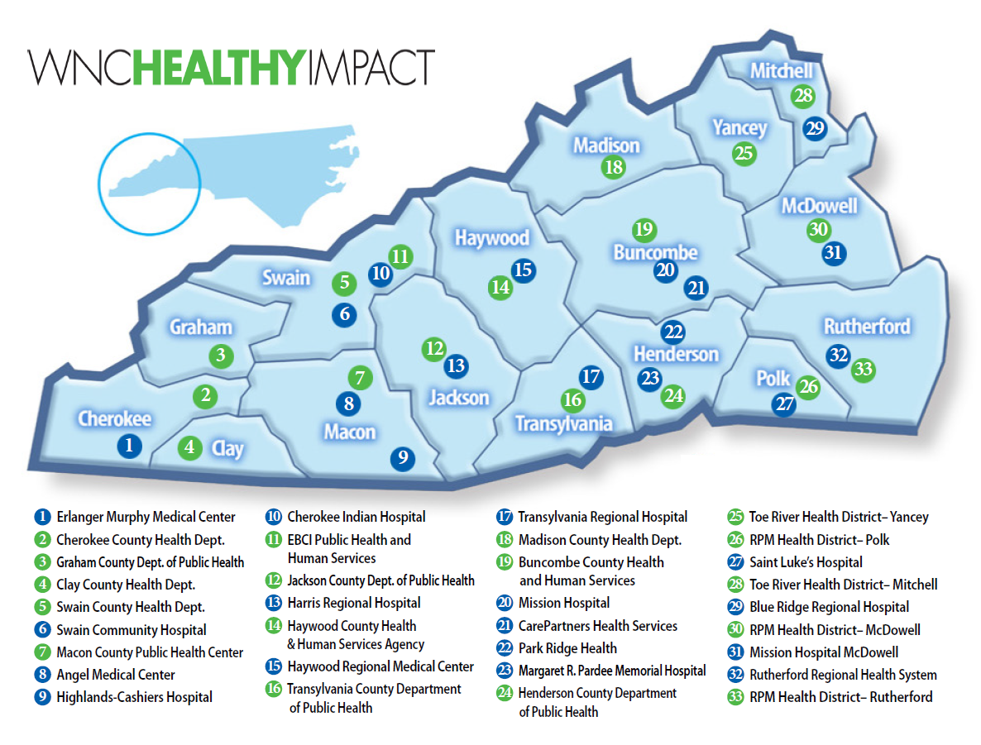

This innovative regional effort is supported by financial and in-kind contributions from hospitals, public health agencies, and partners, and is housed and coordinated by WNC Health Network, Inc.
Current efforts to infuse Results-Based Accountability™ throughout this process are supported by a grant from The Duke Endowment.
Notes:
WNC Healthy Impact is a partnership and coordinated process between hospitals, public health agencies, and key regional partners in western North Carolina working towards a vision of improved community health. ALL OF THESE AGENCIES ARE WNC HEALTHY IMPACT. We are working together locally and regionally to assess health needs, develop collaborative plans, take action, and evaluate progress and impact.
This innovative regional effort is supported by financial and in-kind contributions from hospitals, public health agencies, and partners, and is housed and coordinated by WNC Health Network, Inc. Current efforts to infuse Results-Based Accountability throughout this process are supported by a grant from The Duke Endowment.
This map represents the current partners in WNC Healthy Impact. It takes all of us to accomplish our work together.

Slide 7
Enhances partnerships between hospitals and health departments
Improves efficiency, quality, and standardization of community health assessment data collection and reporting (all reporting)
Encourages strategic investment of community resources to address priority health issues
Impacts health through catalyzing and coordinating action among existing and new assets and initiatives to address priority health needs
Monitors results to improve process, quality, and outcomes
Promotes accountability of hospitals and health departments through meeting community health improvement requirements at state and national level
with a vision of improving health for all of western North Carolina - Coordinated by WNC Health Network, Inc.
Notes:
These are the goals that currently drive our work. They have been tweaked over time as we get more clarity of purpose and destination.

Slide 8
Context: Making Sense of Story Data
Sharing experiences in planning and/or conducting Listening Sessions

Slide 9

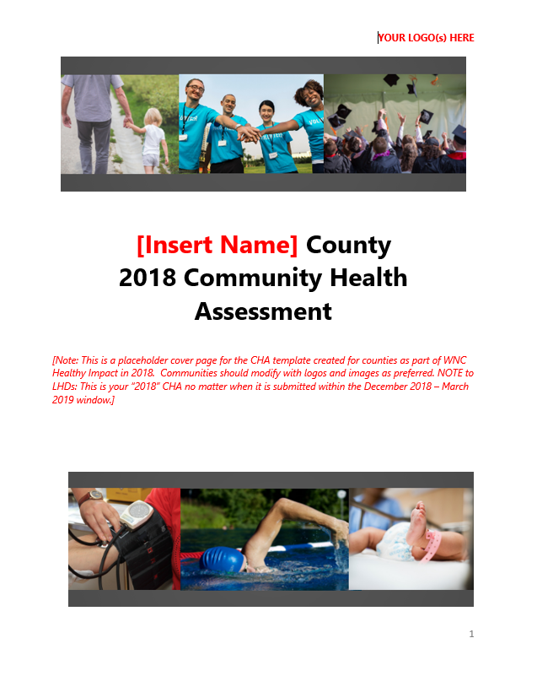

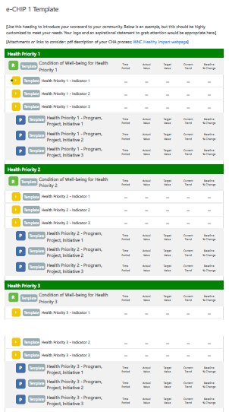
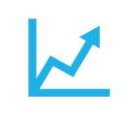
Community Health Improvement Process
Collect & Analyze Community Data
Decide What is Most Important to Act On
Phase 3
Oct. 2019 – Dec. 2020
Phase 1
Jan. 2018 – Mar. 2019
Continuous Action &
Ongoing Evaluation
Take Action & Evaluate Health Improvement
Community Health Strategic Planning
Phase 2
Apr. 2019 – Sep. 2019
Notes:
RR
Key Point: Story data is useful and impactful at every phase of the cycle. Many present are thinking about using story data with number data to present key health issues during prioritization. Some want to include story data in their published CHA. Remember that listening sessions and understanding that story data can help you understand the story behind the curve or what people most affected by a health issues think would work to do better when you are developing your community health improvement plan. As you’re implementing your plans, this kind of data can help you understanding what’s working well and what’s not working well.
------------------------
Generic text that goes with cycle image:
At it’s core, WNC Healthy Impact is about supporting local public health agencies and hospitals to achieve excellence in collaborative community health improvement.
This modified version of the RWJF Take Action Cycle summarizes what we are doing together. This is a continuous improvement cycle – 3 years – that we now support regionally. The first three steps (compile data, analyze and prioritize need) comprise the Community Health (Needs) Assessment.
To improve health across the region, we follow the cyclical 3-year community health improvement process, which is considered national best practice and is required for many agencies for accreditation, including health depts. in NC. It’s required for non-profit hospitals, although it’s considered best practice for all hospitals regardless of tax status.
The first three steps make up the CHA. These are happening in 2018 for all western NC counties. In 2019, action plans will be due. From then until the next cycle, you’re implementing the things in your action plan and seeing if they’re helping, except in reality you’re already doing that all the time and never stop.
Once priorities are set, the cycle moves to creating a community-wide shared action plan, which represents the efforts of local of agencies and individuals. The bulk of the work during the three year cycle is really on this last step, “doing the work and knowing if the it’s making any difference.” So that’s where we’ve shifted most of our support in recent years. We now use RBA to help us do that.
Community health assessment is a systematic examination of the health status indicators for a given population that is used to identify key problems and assets in a community.
The ultimate goal of a community health assessment is to develop strategies to address the community’s health needs and identified issues.

Slide 10
How Did it Go?
Sharing experiences in planning and/or conducting Listening Sessions
Notes:
RR:
Lead a debrief about their experience conducting listening sessions.
O: Show of hand of who has conducted listening sessions since the last training. What types of audiences and locations?
R: Let’s here some of the fun you had. What was exciting or surprising about your sessions? So, any tough moments or tough crowd? Challenges?
I: As you put this to work, what are you learning? What seems important about this type of data?

Slide 11
Making Sense of Story Data
Getting familiar with your data
Discovering clusters & themes
Displaying & communicating your discoveries
Notes:
EB – quick overview

Slide 12
Getting Familiar with Your Data
Notes:
Review notes
Review audio recording
Transcribe audio recording?
Pull out key ideas (maybe more than one idea per statement)
Organize ideas but what question they are answering (at least, initially)

Slide 13
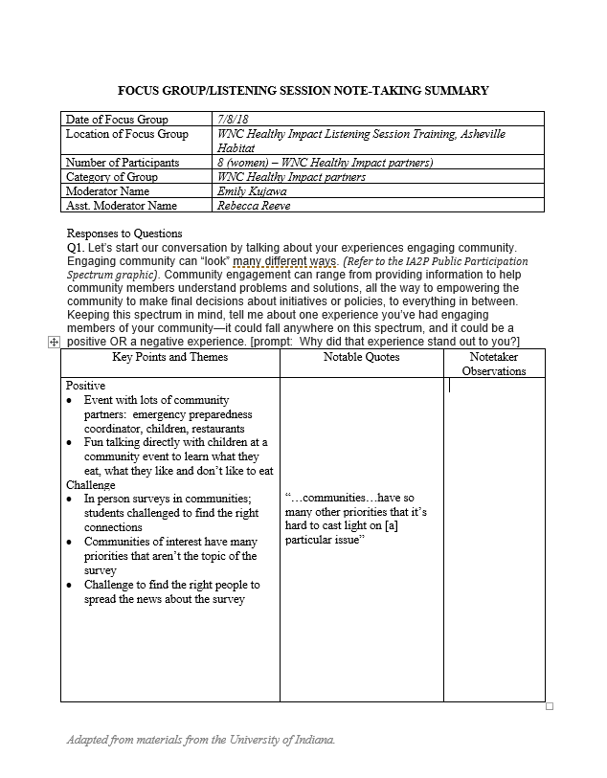
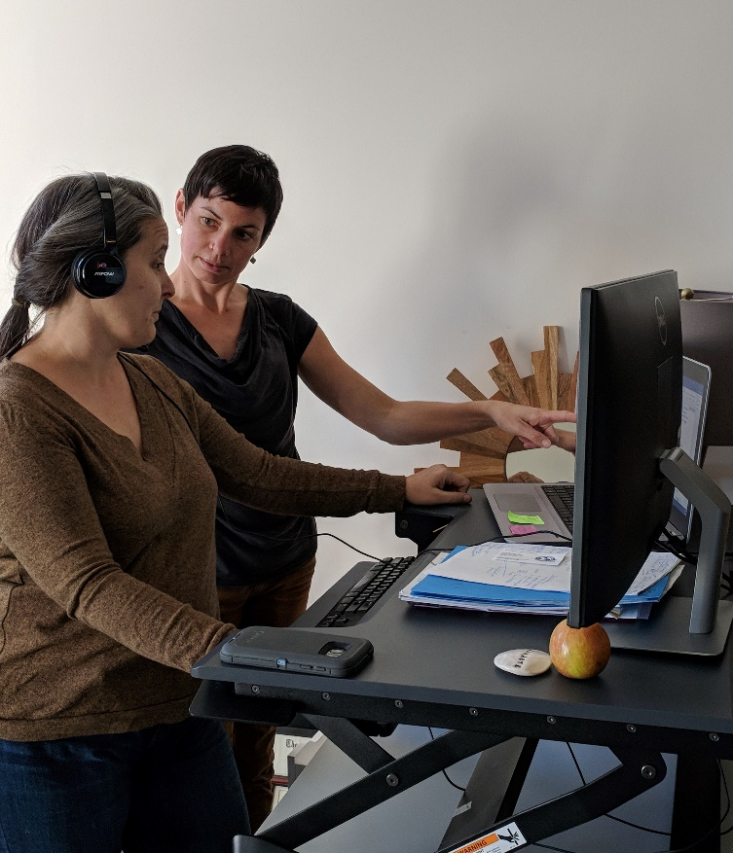
How We “Got Familiar” with Our Data
Notes:
Review notes
Review audio recording (work with your partner)
Transcribe audio recording? 45 minutes -> 6 hours
Pull out key ideas (maybe more than one idea per statement)
Organize ideas but what question they are answering (at least, initially)

Slide 14
Discovering Clusters & Themes
Activity/Experience
Debrief from activity
Notes:
EB: Let’s just dive in and do it!
RR: brief debrief

Slide 15
Lunch!
Notes:
Aiming for 11:45

Slide 16
How can you use your “sense-making” superpowers?
To analyze data from:
  Key informant interviews
  Listening sessions/focus groups
To understand and describe what works
To support quality improvement
  Meeting feedback
  Message testing
  Program improvement
  Strategic planning
Notes:
RR
Turn and talk to the person next to you and share some ideas about how you could see using these skills. (have some individuals report back, briefly)

Slide 17
Tips for better & easier “sense-making”
Mindset is important
  Impartiality
  Curiosity
  Advocate/Amplify
Keep your end goal in mind
  Consider the many ways to pair/theme your data
Make the process work for you
  Moderator and co-moderator both involved
  Create a block of dedicated, uninterrupted time
  Spread out!
  Highlight/underline key words
Notes:
RR & EB: I feel like we could share this one. Maybe I could provide the basic skeleton and you can add your expertise to flesh it out.
“Before you all head into practice, we want to help you think about your approach to making sense of your listening session data.”
You are the tool!
High quality qualitative data analysis is:
Systematic (deliberate and planned, not capricious, arbitrary, or spontaneous)
Verifiable (someone else could look at the raw data and reach the same conclusions you do. To achieve this: minimize role that personal bias plays.
Being a “good” qualitative data analyst requires you approach the data with an open mind, without preconceived ideas of what it will say or what you WANT it to say. Being aware of any bias you may bring in (e.g., if you manage the program that participants provide feedback on). You must have true interest in seeing what the data is REALLY saying, not what is convenient or what you WANT it to say. Be aware of your own personal biases and pre-existing ideas or knowledge about the topic of your listening session. It’s easy to have hunches about what you might learn, and find any evidence confirming that hunch to leap to conclusions. Challenge yourself to suspend what you know (or THINK you know) about the topic! See if you find anything that surprises you.
Your curiosity to find the unexpected will help you set aside your bias and be open to whatever insight emerge.
Remember: data analysis is an opportunity for you to be an advocate for your listening session participants: to accurately reflect their comments and feedback is you being an advocate and elevating their voices.
The purpose for the data drives the type of analysis (why am I collecting this information?)
Think about how it will be used, who will it be shared with, etc.
It can be really helpful to revisit your purpose before you begin analyzing data, to remind yourself of the MOST important things to pay attention to (so you don’t get overwhelmed or bogged down with less important details). Good sense-making (analysis) starts with developing good questions before you collect data!
Examples of purposes:
I want to understand how parents of students in my school system perceive the services we are offering to low-income students.
I want to learn about the reasons why veterans in my community are, or are NOT, accessing services through the VA.
ASK THE GROUP TO NAME THEIR PRIMARY PURPOSE FOR DATA COLLECTION.
We talked about debriefing with the moderator and co-moderator after your session. Some helpful questions for you to discuss with each other include:
What were the themes we heard?
What are the most important points we’ve learned from this group?
What was surprising or unexpected?
What quotes were particularly helpful?
How was this group similar to or different from other groups we’ve done (if applicable)?
Does anything need to be changed before the next group (if applicable)?

Slide 18
Practice Time!
Notes:
Working in pairs.
Hand out material packets.

Slide 19
Instructions for Practice:
Select 5-7 paper strips
One idea per strip of paper
Make pairs
Add strips until 4-6 pairs
“Cluster” the pairs
Add “lone” ideas to clusters
“What’s happening” in cluster? [highlight key words]
Label the cluster
Save your work
Complete Data Reporting Form
Notes:
EB organize people and review instructions
Address the possibility of uncovering “answers to unasked questions”
Address outliers (e.g., someone has a totally different experience than others in the group—how to cluster and analyze that data)
In real life, you would do this for every questions. Often you’ll need to move information around - an “answer” during the Q2 section might actually answer Q4.

Slide 20
Reflection
You just practiced analyzing local, primary, qualitative data via constant comparison analysis ☺
Notes:
O: [we recap what we just did]
R: Anyone have fun? Any sticking points?
I: Any new insights into the value and making sense of story data in this way?
P.S. We’ve been calling this process “making sense of story data,” but there’s actually an academic name for what you just did…
[This appears with the mouse click: You just practiced analyzing local, primary, qualitative data via constant comparison analysis ☺]

Slide 21
Other Techniques for Discovering Clusters & Themes
Electronic
Software
  e.g. NVivo
This Photo by Unknown Author is licensed under CC BY-SA-NC
Notes:
Computer based (alternative to printing/cutting paper): Word doc (highlight/color-code)
qual analysis software (better for large volumes of data or very complex analysis, probably not ideal for this type of work (e.g. Nvivo)

Slide 22
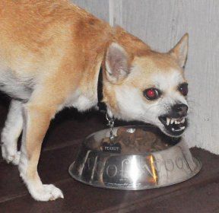
What Else Do You Know?
Quotes
Body language/non-verbal communication
Note taker observations
Outliers
Notes:
These are clues to analyzing
Key informant quotes are currently organized into themes
Is attitude conveyed an important part of answering the key question you have? Then noticing patterns of body language could be helpful.

Slide 23
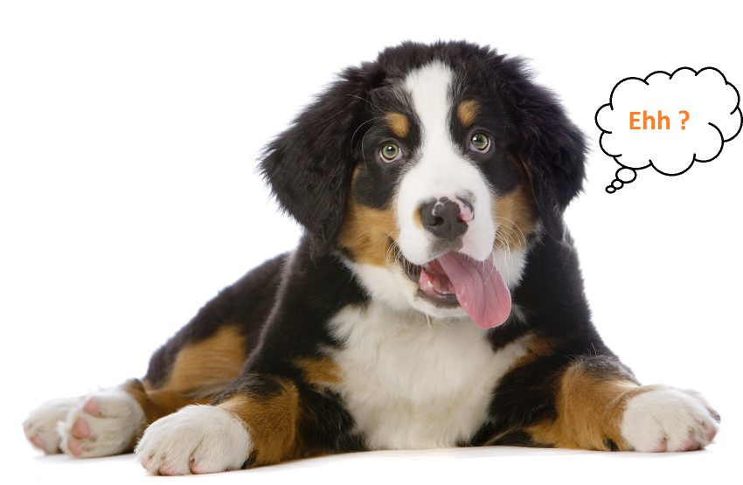
Displaying & Communicating Your Discoveries
Notes:
Adrienne kicks off this section
(or composite) Creating composite character to illustrate insights that emerged (e.g. 20 year old farmer and 60 year old farmer)

Slide 24
Communication Imperatives
Story data can help us achieve some of the most critical communication imperatives for engaging stakeholders:
Step into the world of your audience.
Communicate in images.
Tell stories.
Notes:
Why do we want to share what we’ve learned through our story data?
What is the best way to communicate this data?
It’s important to start by thinking about some of the key imperatives of communications (adapted from a great webinar presented by Stanford Social Innovation Review – contact me if you want to access this webinar.)
We think that people fail to take action or join our cause because they lack information – but this isn’t the case. The reality is that people don’t act because they don’t care or they don’t know how. Our job is to figure out how to change that.
When we think about communicating our data, it comes back to the same question Erin always drives home – data for what? Who is our audience, how do we get them to care, and what do we want them to do with the information?

Slide 25
County Commissioners?
Concerned Citizens?
School Administrators?
Tribal Council?
Boards of Health?
Agency Leaders?
Notes:
STEP INTO THE WORLD OF YOUR AUDIENCE
Who is your audience – what are their values, and where do their values intersect with your values? Put yourself in their shoes. What do they think about every day? What problem are they trying to solve? People are motivated to consume information that resonates with how they see themselves. How can our message help them solve their problem?
RBA – think about “communication power” criteria for selecting headline data

Slide 26
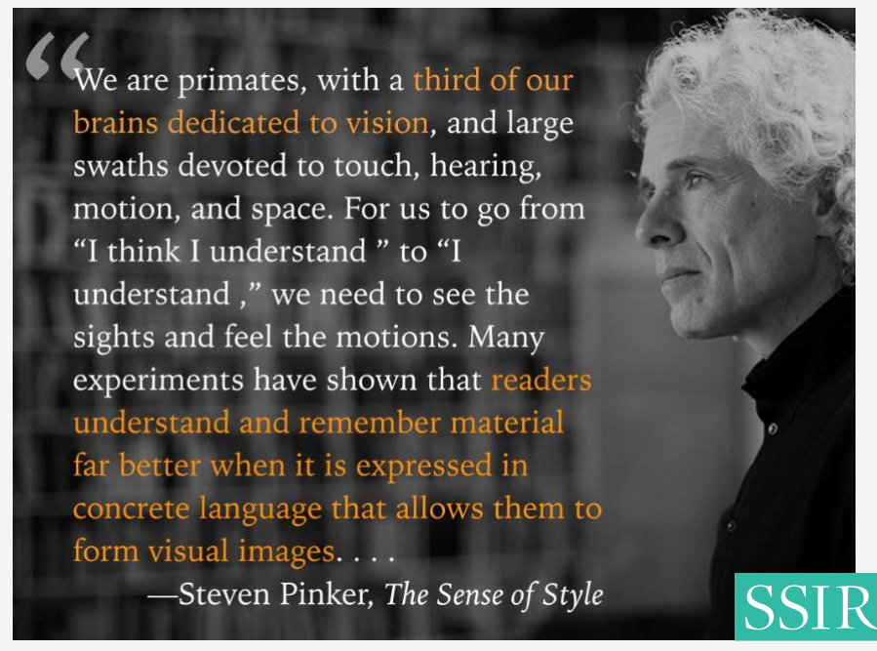
Notes:
COMMUNICATE IN IMAGES
Look for opportunities to connect to image or specific experience if you want your audience to remember what you’re saying.
Help them connect to their own experiences.
Hand-brain model – charts = cortex, story data gets to the amygdala

Slide 27
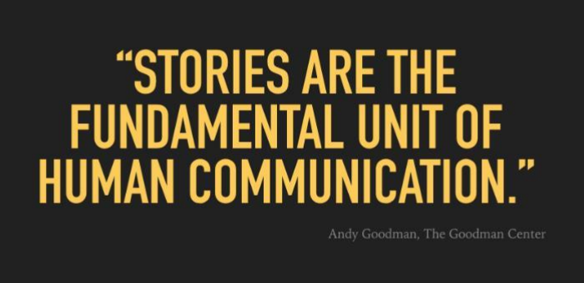
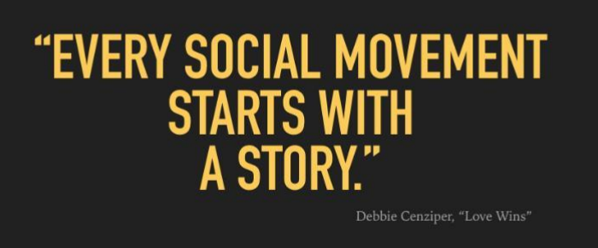
Notes:
Story data does exactly that – it creates a story around our issues.
Stories connect to what our audience already knows – they are the building blocks of memory.
If we’re not telling stories people will create their own narrative.
Fill in gap –tell story behind data

Slide 28
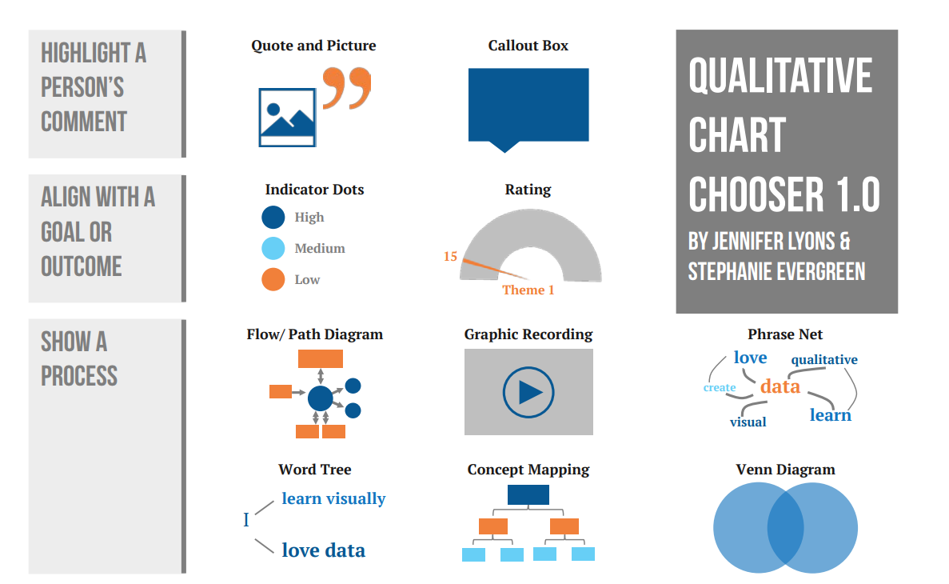
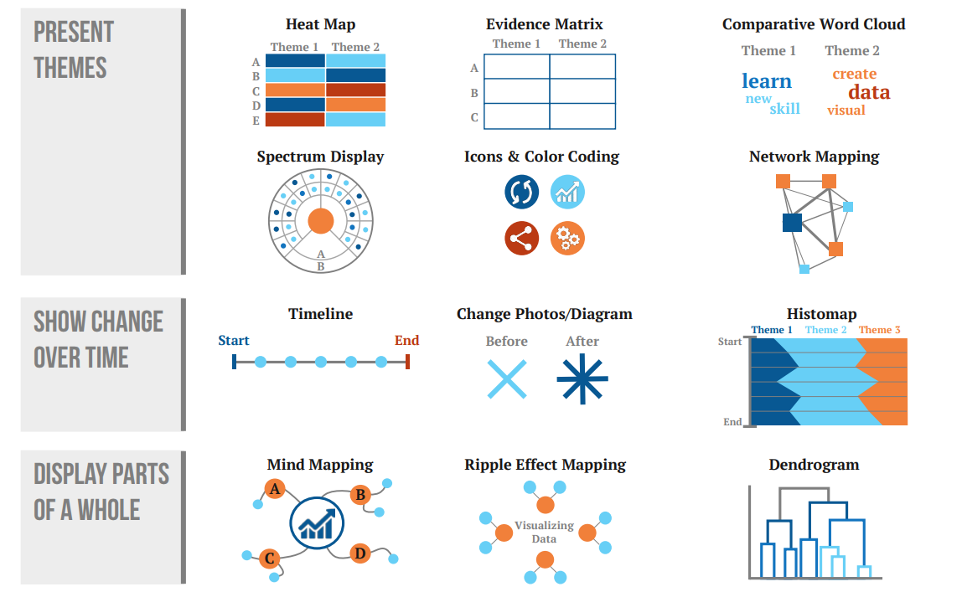
Notes:
Here is a great visual that demonstrates all of the ways charts can be created to share qualitative, or story data. We don’t expect you to run out and do this – although some of these we can help you create.
But we need to start by knowing our audience. What will work best for them? What will help you tell the story in a way that builds their curiosity?
And what do we have the technical capacity to create?

Slide 29



Barriers to Accessing Health Care
 | No reliable personal transportation
 | Community lacks specific types of providers
 | Can’t afford medication
Notes:
Could be icons or photos from your community that represent

Slide 30
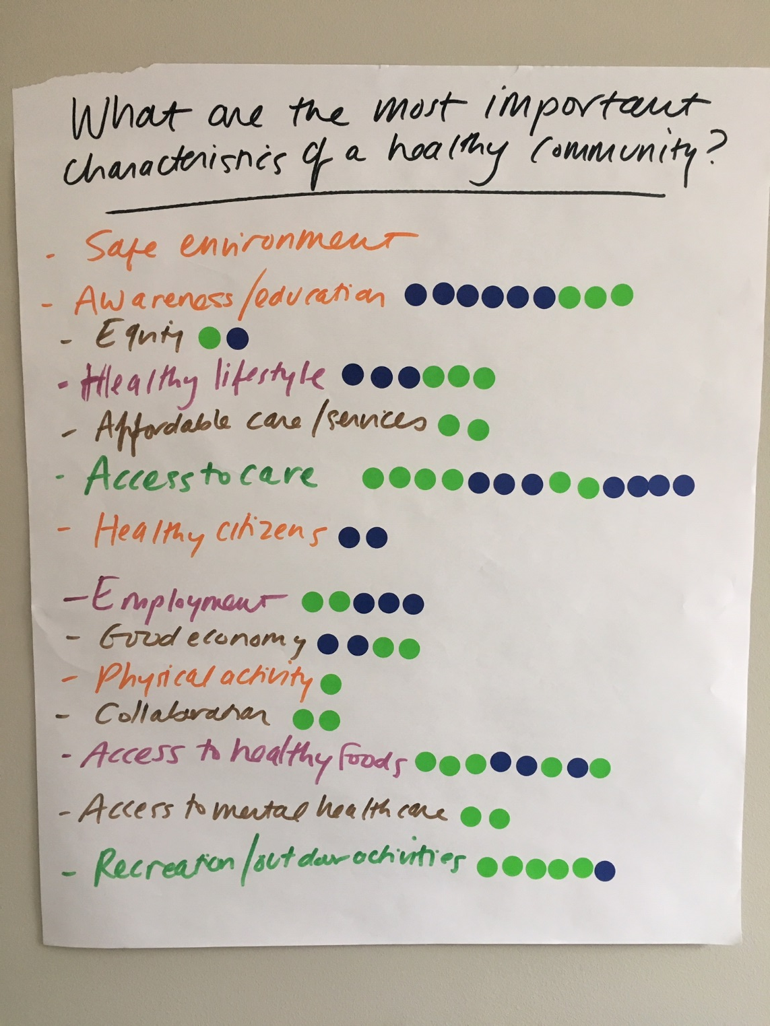
Notes:
From 2018 Key Informant survey – characteristics of a healthy community:
You can create a word cloud to make a simple visual – or even include a photo from your process!
Jackson county did this

Slide 31

Notes:
From 2018 Key Informant survey – characteristics of a healthy community:
You can create a word cloud to make a simple visual – or even include a photo from your process!
Free tools – I can help with so that branding is consistent with your report etc.

Slide 32

“Cancer is a health issue that most every family in our county has been impacted by; the population has seen first-hand its impact.
There is a lot of community effort and buy-in already well- established.”
- Social Services Provider
Notes:
From 2018 Key Informant survey – characteristics of a healthy community:
If in your listening session you asked what are you biggest health concerns – in analysis one of the themes that came up was issues that people have first-hand experience impacting their family – example of where a quote would be highly relevant in illustrating a key theme.

Slide 33
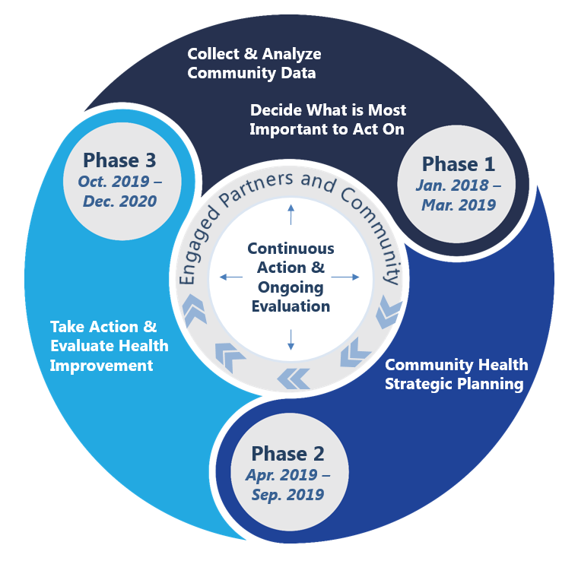
Communicating “Story Data” Findings
Prioritization
  Handout: Key Health Issue Data Summary
Community Health (Needs) Assessment
  Presenting insights related to priority health issues
  CHA Document (e.g. Community assets)
Community Health Improvement Plan or Hospital Implementation Strategy
  Story Behind the Curve
  What Works Brainstorm ->Strategic Directions
Program monitoring and improvement
  Meeting feedback
  Quality performance measures
  Story Behind the Curve (from those most affected)
Notes:
Hand over to Erin
Mini Brainstorm: where would you include story data insights? What audience? What support?
(or composite) Creating composite character to illustrate insights that emerged (e.g. 20 year old farmer and 60 year old farmer)
REPORTING FORMATS:
When writing summary/report:
Structure it around the questions or cross-cutting themes
Include a brief summary of the comments
Illustrate with 1-3 quotes that are illustrative of the theme particularly well.
Do you want to include your own interpretations or recommendations/advocacy? May be useful if you are using the data to inform decision making. MAKE IT CLEAR what content in the report are your recommendations (vs data/observations)
Avoid trying to quantify comments/themes (e.g., “30% of listening session participants said access to transportation was a barrier to getting to doctor’s appointments”). Qualitative data collection is not an attempt to generate data that is generalizable to a broader population. If you do want to communicate frequency, use words like “no one, a few, many, most, or all”.
Examples:
Pairing quantitate & qualitative
Quotes in the RBA Turn the Curve: Results, Story, Partners, What Works
Who are your key audiences?
Community/Agency leadership
Program director
School administrators
Funders
Program participants
Listening session participants
The community
Other ways to report data:
Annual report for agency/organization
In reports/summaries to inform strategic planning
Other reporting methods:
Diagrams/sketches/other visuals?
Ask the group: how else might you want to share or report your data?

Slide 34
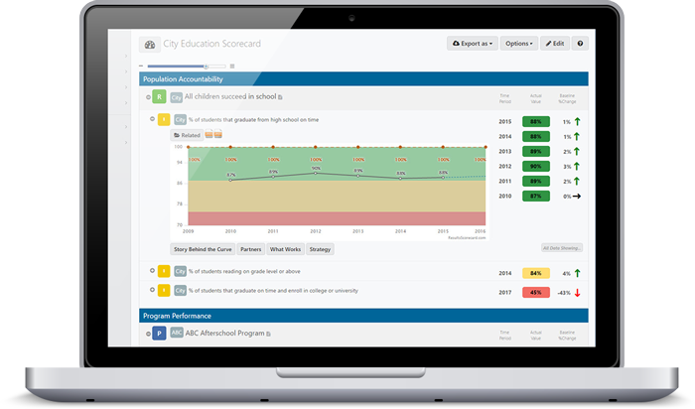
Ways to Communicate/Report “Story Data” Findings

Slide 35
“Story Data” Reporting:
Best Practices & Considerations
Sources
  Mention or report the source of data, while maintaining confidentiality
Data Definitions
  Know the exact language of the focus group questions
Methods
  Be prepared to discuss/describe the basic methodology of your data collection and analysis, and know where to direct people if they have further questions
Data Limitations
  Be prepared to discuss the limitations of the data & methodology
    e.g. convenience sampling, small numbers, self-report
Notes:
“audit trail”

Slide 36
“Story Data” Reporting:
Best Practices & Considerations
No personal identifiers or information
  Think beyond the “typical”
Take care with quotes
  Remove identifying content
  Identify with “quotation marks”
  Get permission to use quotes (even if anonymous)
  Use quotes to support themes
Notes:
*did we include permission to use quotes anonymously? In first training*
Add some thoughts/comments about check-in with participants that what you elevate as their key themes resonate with them, before you elevate it up
Nothing that could be traced to an individual:
In very small populations, identifying information (even within quotes) may also include location of residence, etc. Think carefully—if a community member were to read this information, could they tell who said it?
Within these small populations or communities, these identifiers may extend beyond typical identifiers (name, address, etc.) and may include occupation (“Coach”), health history, address, etc.
REPORTING FORMATS:
When writing summary/report:
Structure it around the questions or cross-cutting themes
Include a brief summary of the comments
Illustrate with 1-3 quotes that are illustrative of the theme particularly well.
Do you want to include your own interpretations or recommndations? May be useful if you are using the data to inform decisionmaking. MAKE IT CLEAR what content in the report are your recommendations (vs data/observations)
Avoid trying to quantify comments/themes (e.g., “30% of listening session participants said access to transportation was a barrier to getting to doctor’s appointments”). Qualitative data collection is not an attempt to generate data that is generalizable to a broader population. If you do want to communicate frequency, use words like “no one, a few, many, most, or all”.

Slide 37
Reflection

Slide 38
Next Steps & Wrap-Up
Contact us for one-on-one process or communications support
Study Hall
  Thursday, November 15, 10-2, location TBD
  CHA template release & support for “sense-making”
Getting to Results (RBA training)
  January, TBD
  Looking for location host
Exit Survey
Notes:
Nothing that could be traced to an individual:
In very small populations, identifying information (even within quotes) may also include location of residence, etc. Think carefully—if a community member were to read this information, could they tell who said it?
Within these small populations or communities, these identifiers may extend beyond typical identifiers (name, address, etc.) and may include occupation (“Coach”), health history, address, etc.
REPORTING FORMATS:
When writing summary/report:
Structure it around the questions or cross-cutting themes
Include a brief summary of the comments
Illustrate with 1-3 quotes that are illustrative of the theme particularly well.
Do you want to include your own interpretations or recommndations? May be useful if you are using the data to inform decisionmaking. MAKE IT CLEAR what content in the report are your recommendations (vs data/observations)
Avoid trying to quantify comments/themes (e.g., “30% of listening session participants said access to transportation was a barrier to getting to doctor’s appointments”). Qualitative data collection is not an attempt to generate data that is generalizable to a broader population. If you do want to communicate frequency, use words like “no one, a few, many, most, or all”.

