Slide 1

2018 Community Health Assessment Data Summary
[TEMPLATE]
Co-brand with your logo here

Slide 2
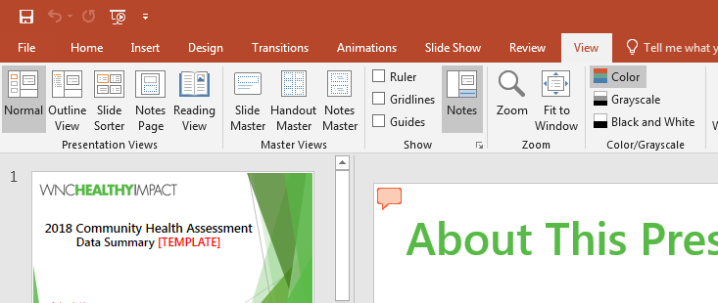
About This Presentation Template
Background Slide – not for public
The goal of this slide template and the accompanying guidance document is to guide the local team responsible for the CHA/CHNA in:
  Making decisions about what the primary & secondary data means,
  What indicators are most important for a community to see, and
  How to display that data in a presentation format.
Add your organization’s logo into the slide deck by going to the “View” tab and then selecting “Slide Master”
Throughout these slides:
Red text = Guidance (Remove before presenting)
Highlight = Replace with your own text
Notes:
Guidance for Presenters:
Don’t forget to remove this slide before presenting!

Slide 3
About This Presentation Template
Background Slide – not for public
The purpose of this slide deck is to get you started in thinking about how to structure your data presentations, and how to format your slides.
You may tailor this presentation for a variety of audiences, including your data prioritization team, leadership boards, public officials, and/or the general public.
You can determine what data to include by reviewing the suggested slide outlines or going through the data prioritization process.
Our team at WNC Health Network is happy to support you! Reach out to us if you need assistance with creating or preparing for presentations.
Notes:
Guidance for Presenters:
Don’t forget to remove this slide before presenting!

Slide 4
Overview
Result We Have In Mind
CHA Process and WNC Healthy Impact
Methodology
General Demographics of [Insert County Name]
Community Strengths/Positive Changes [and Community Resources]
Areas for Growth/Negative and/or No Changes [and Community Resources]
*County Health Priorities/How & Why They Were Chosen [and Community Resources]
Call to Action/Action Plan
Notes:
Guidance for Presenters:
The purpose of the overview slide is to give your audience of an idea of what information they will receive during the course of your presentation.
Update the Overview to reflect the outline of your presentation.
You may want to tailor your presentation and what is included based on your audience and how much time you have.
County Health Priorities is starred because – depending on where your community is in your cycle – you may have not finalized your priorities yet.
Consider mentioning 211 as a resource for your community.

Slide 5
Desired Result
What is the desired result of your meeting/ presentation?
Notes:
Guidance for Presenters:
Begin the presentation by stating what you hope to accomplish during your time.

Slide 6

WNC Healthy Impact and Community Health Assessment
Notes:
Guidance for Presenters:
You may use this background photo, change out with a photo from your community, or use a free stock image website like www.pexels.com or www.pixabay.com to find another photo.

Slide 7


Community Health
Improvement
Process
Collect & Analyze Community Data
Decide What is Most Important to Act On
Phase 3
Oct. 2019 – Dec. 2020
Phase 1
Jan. 2018 – Mar. 2019
Continuous Action &
Ongoing Evaluation
Take Action & Evaluate Health Improvement
Community Health Strategic Planning
Phase 2
Apr. 2019 – Sep. 2019
Notes:
Speaking Notes for Presenters:
The Community Health Improvement Process refers to the entire, ongoing, iterative process that includes creating community health improvement plan (CHIP), community health assessment (CHA) and community health needs assessment (CHNA) reports. It also includes all of the action and evaluation that is needed to implement and monitor the strategies outlined in the CHIP – created by hospitals, health departments, engaged community members, and partners. To align timing requirements, collaborating agencies in western NC have chosen to repeat this cycle every three years.
What are the key phases of the Community Health Improvement Process?
In the first phase of the cycle, CH(N)A leads collect and analyze community data – deciding what data they need and making sense of it. They then decide what is most important to act on by clarifying the desired conditions of wellbeing for their population and by then determining local health priorities. The first phase results in the Community Health Assessment Report from public health, and the Community Health Needs Assessment Summary from hospitals.
The second phase of the cycle is community health strategic planning. In this phase, leads make a plan with partners about what works to do better, form workgroups around each strategic area, clarify customers, and determine customer results and measures. The second phase results in a Community Health Improvement Plan (CHIP) and Action Plan forms from public health, and in a Hospital Implementation Strategy from hospitals.
In the third phase of the cycle, CH(N)A leads take action and evaluate health improvement. They do this by planning how to achieve customer results and putting the plan into action. Workgroups continue to meet, and monitor customer results and make changes to the plan as needed. The third phase results in a State of the County Health (SOTCH) Report from public health, and in an IRS Form 990 – Schedule H from hospitals.

Slide 8
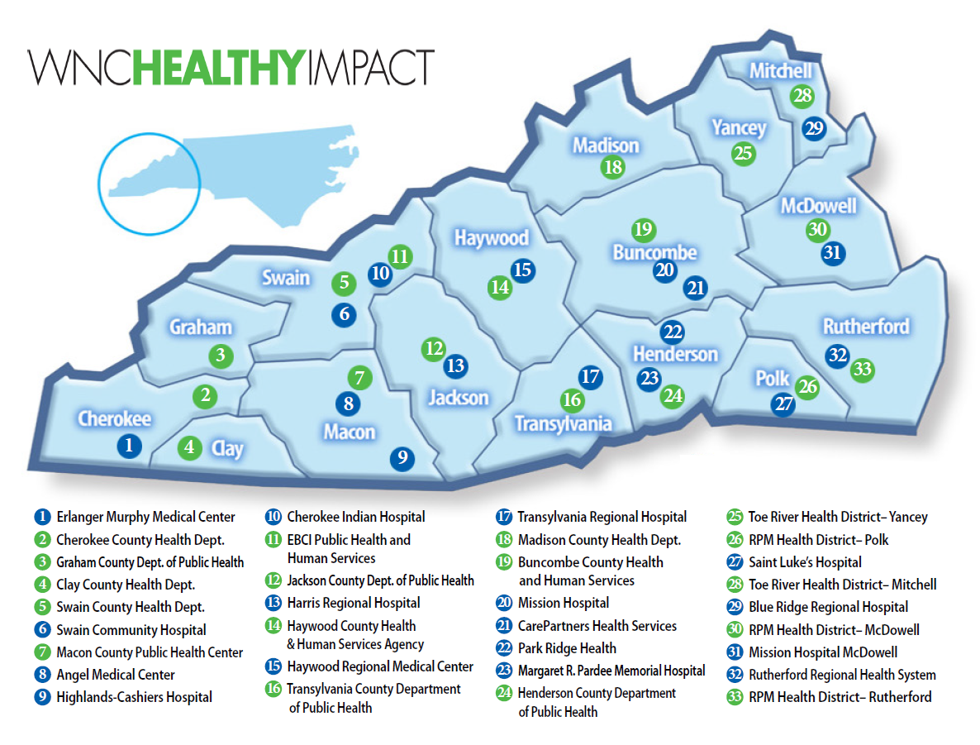

This innovative regional effort is supported by financial and in-kind contributions from hospitals, public health agencies, and partners, and is housed and coordinated by WNC Health Network, Inc.
Current efforts to infuse Results-Based Accountability™ throughout this process are supported by a grant from The Duke Endowment.
Notes:
Speaking Notes for Presenters:
WNC Healthy Impact is a partnership and coordinated process between hospitals, public health agencies, and key regional partners in western North Carolina working towards a vision of improved community health. ALL OF THESE AGENCIES ARE WNC HEALTHY IMPACT. We are working together locally and regionally to assess health needs, develop collaborative plans, take action, and evaluate progress and impact.
This innovative regional effort is supported by financial and in-kind contributions from hospitals, public health agencies, and partners, and is housed and coordinated by WNC Health Network, Inc. Current efforts to infuse Results-Based Accountability throughout this process are supported by a grant from The Duke Endowment.
This map represents the current partners in WNC Healthy Impact. It takes all of us to accomplish our work together.
What is WNC Healthy Impact’s regional role in all of this?
WNC Healthy Impact is a partnership and coordinated process between public health, hospitals, and key regional partners in western North Carolina. This regional effort is supported financially by all the hospitals in the region, and is housed and coordinated by WNC Health Network.
Through in-kind partner time and leadership, consultants, and WNC Health Network staff, this effort creates and provides multiple datasets, trainings, tools and templates, and provides technical assistance to public health agencies and hospitals. This regional support is designed to enhance the local efforts that work with partners to assess health needs, develop collaborative plans, take action, and evaluate progress and results.

Slide 9

Enhances partnerships between hospitals and health departments
Improves efficiency, quality, and standardization of community health assessment data collection and reporting (all reporting)
Encourages strategic investment of community resources to address priority health issues
Impacts health through catalyzing and coordinating action among existing and new assets and initiatives to address priority health needs
Monitors results to improve process, quality, and outcomes
Promotes accountability of hospitals and health departments through meeting community health improvement requirements at state and national level
with a vision of improving health for all of western North Carolina - Coordinated by WNC Health Network, Inc.
Notes:
Speaking Notes for Presenters:
These are the goals that currently drive our work. They have been tweaked over time as we get more clarity of purpose and destination.

Slide 10
WNC Healthy Impact Organizational Chart
WNC Hospital Leaders
WNC Healthy Impact Steering Committee*
(Health Department & Hospital Representatives, Strategic Regional Partners, WNC Health Network)
WNC Health Network
WNC Local Health Directors
WNC Healthy Impact Members
(Public Health & Hospital Representatives)
Communications Workgroup*
Data
Workgroup*
Data Consulting Team
Results-Based Accountability Workgroup*
RBA Consulting Team
Community-Level Partners and Stakeholders
*Led and facilitated by WNC Health Network staff
Notes:
Speaking Notes for Presenters:
To operationalize how we work across the entire region to accomplish those goals, here is our structure:
WNC Healthy Impact is driven by a collaborative steering committee that provides operational support for the initiative and is informed by continuously evolving task-related work groups.
Work group members include staff of hospitals, health departments, and partner agencies across the region.
In addition to local involvement, hospital representatives also serve on the project steering committee and regional workgroups.
The specifics of the work are guided by evidence-based approaches to implementing and communicating change and understanding its impact.
This innovative regional effort is supported by financial and in-kind contributions from hospitals, public health agencies, and partners, and is housed and coordinated by WNC Health Network, Inc., and is funded by the hospital systems in western North Carolina.
Current efforts to infuse Results-Based Accountability throughout this process are supported by a grant from The Duke Endowment.

Slide 11
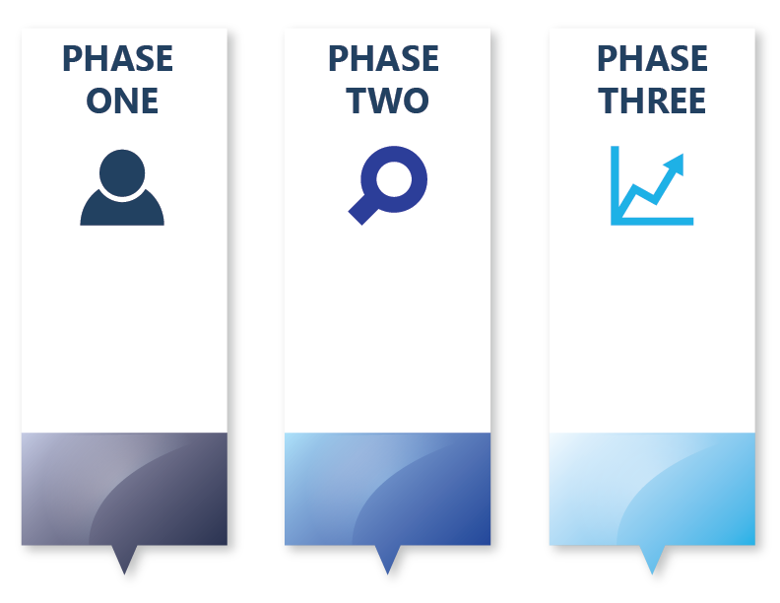
Community Health
Improvement
Timeline:
What Needs to Get Done?
Collect + Analyze Community Health Data
Decide what you need
Make sense of data
Decide What Is Most Important To Act On
Clarify desired conditions of wellbeing for your population
Determine local health priorities
Community Health Strategic Planning
Make a plan with partners about what works to do better
Form workgroups around each strategic area
Clarify customers
Determine performance results and measures
Take Action and Evaluate Health Improvement
Plan how to achieve customer results
Put plan into action
Workgroups continue to meet
Workgroups monitor customer results and make changes to plan
Jan. 2018 – Mar. 2019
Apr. 2019 – Sep. 2019
Oct. 2019 – Dec. 2020

Slide 12
Community Health
Improvement
Timeline:
What Products Do You Walk Away With?
Public Health Products
& Reporting:
Community Health Assessment (CHA) Report
Hospital Products
& Reporting:
Community Health Needs Assessment (CHNA) Summary
Public Health Products
& Reporting:
Community Health Improvement Plan (CHIP)
Action Plans (Long Term/ Short Term)
Hospital Products
& Reporting:
Hospital Implementation Strategy
IRS Form 990- Schedule H
Public Health Products
& Reporting:
State of the County Health (SOTCH) Report
Hospital Products
& Reporting:
Hospital Implementation Strategy Update
IRS Form 990 – Schedule H
Jan. 2018 – Mar. 2019
Apr. 2019 – Sep. 2019
Oct. 2019 – Dec. 2020

Slide 13

Methodology
Notes:
Guidance for Presenters:
You may use this background photo, change out with a photo from your community, or use a free stock image website like www.pexels.com or www.pixabay.com to find another photo.

Slide 14
Methodology
Product | Source | Description of type of data and source
Community Health Survey | Professional Research Consultants (PRC) | 75 core questions (3 additional local questions) including: demographic, morbidity, behavior, ACEs, etc.
Data Workbook (Survey and Secondary Data) | Publicly available data (U.S. Census, NC State Center for Health Statistics, other state and federal departments) | 175+ Indicators including: demographic, morbidity and mortality, social determinants, environmental indicators, etc.
Online Key Informant Survey | Professional Research Consultants (PRC) | Survey input (story data) from selected individuals to identify major health issues, gaps in services, and other factors that may contribute to health.
Maps | Community Commons and NC State Center for Health Statistics | 23 maps including: selection of population, and morbidity and mortality indicators.
Notes:
Guidance for Presenters:
This slide is a lot for anyone to read and take in and more a slide about. Consider saying to your audience, “there is a clear methodology, and if you'd like to know more about it, see me." You may also have a few hard copies of this on hand for anyone who is wanting to know more.

Slide 15
Methodology
Community Health Survey
    3,265 surveys collected from adults throughout the 16 counties in WNC
    Completed via telephone (landline and cell phone) and online. Administered in both English and Spanish by PRC.
    Weights were added to enhance representativeness of data at county and regional levels.
    The survey instrument was based largely on national survey models such as the BRFSS.
    Sampling levels allow for good local confidence intervals, but keep in mind that error rates are larger at the county level than for WNC as a region.
Data Workbook
    Data Workbook includes both primary (community health survey from 2012, 2015 and 2018) data and secondary data.
    Secondary measures/indicators are included in the data workbook based on WNC stakeholder input
    Secondary data was pulled March 2018 through June 2018
Key Informant Survey
    Administered via email to 329 participants.
    Recommended participants, which included physicians, public health representatives, other health professionals, social service providers, and a variety of other community leaders, were provided to WNC Health Impact by the 16 counties.

Slide 16
Background Slide – not for public
Template Slides for Presenting Data
The following slide templates are to get you started with ways you can format your data slides.
Notes:
Guidance for Presenters:
Don’t forget to remove this slide before presenting!

Slide 17
Example of Slide With Just Text
Bullets here outlining key data or points.

Slide 18
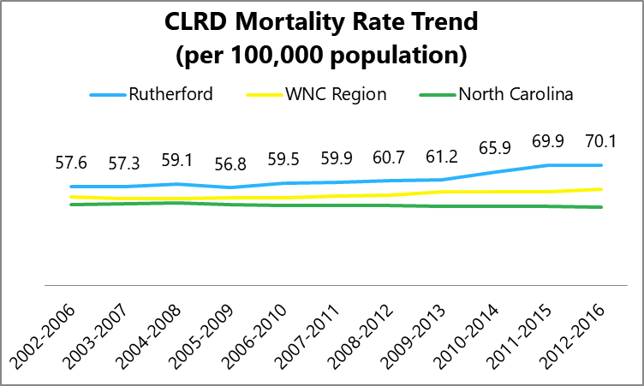
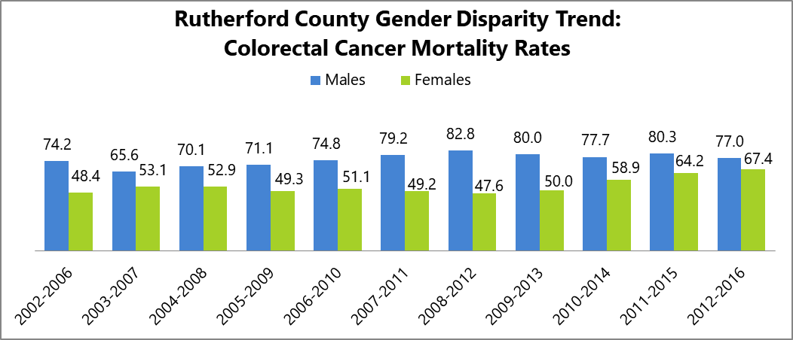
Example of Slide With Data Workbook Charts
Enter bullet here with key data point
Enter bullet here with story behind the data
EXAMPLE
Source: Enter data source here

Slide 19
Example of Slide With Table
 | 2012 | 2015 | 2018
% Smoke Cigarettes
% Use E-Cigarettes
% Current Drinkers
% Excessive Drinkers
% No Leisure-Time Physical Activity
% Eating 5+ servings of fruits/vegetables per day
EXAMPLE
Enter bullet here with key data point
Enter bullet here with story behind the data

Slide 20
Example of Slide Quote from Key Informant Survey
“Include a quote from the Key Informant Survey that highlights the data.”

Slide 21
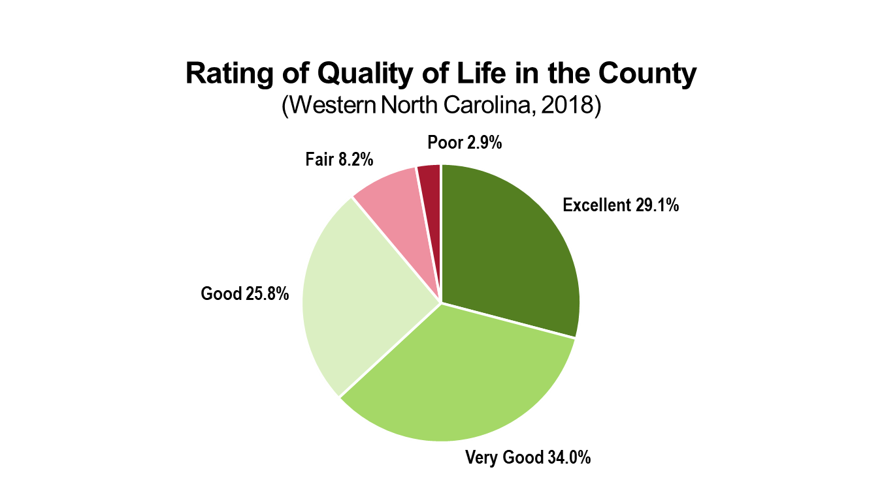
Example of Slide With PRC Charts
Enter bullet here with key data point
Enter bullet here with story behind the data
EXAMPLE
Source: Enter data source here

Slide 22
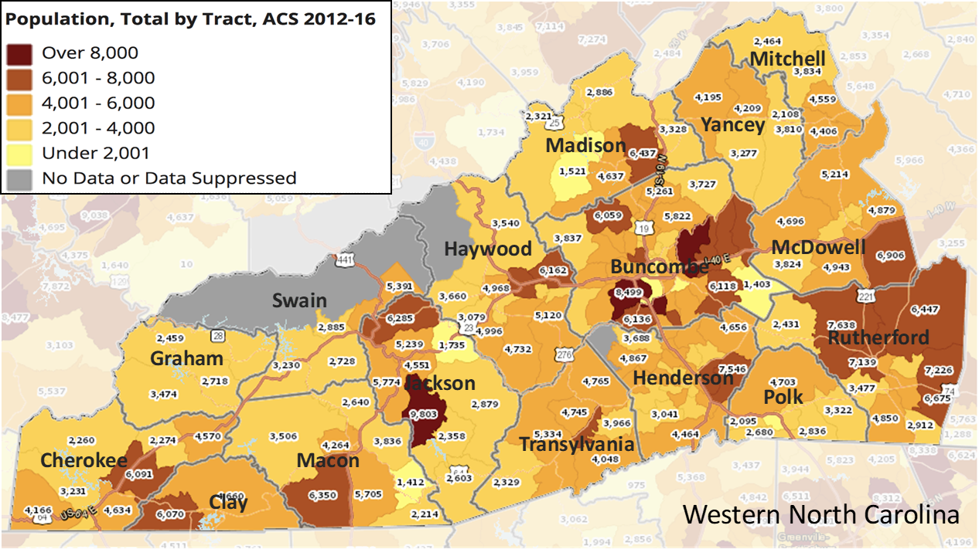
Example of Slide With Maps
Enter bullet here with name of map
Enter bullet here with map talking points (located in Maps PPT notes sections)
EXAMPLE
Source: Enter data source here

Slide 23
Causes of Death Chart Explained
Insert your county’s Cause of Death chart
Ranking is based on Death Rate and not # Deaths.
This is because # Deaths only represents the total number of deaths during a stated time frame. The number cannot be age-adjusted, and therefore cannot be used for comparison or ranking.
Death rate, in this table, is age-adjusted to the “standard” population. It represents the number of deaths in the population during stated time frame/population x 1,000.
Age adjusting rates is a way to make fairer comparisons between groups or communities with different age distributions.
  A county with a higher percentage of older adults may have a higher rate of death or hospitalization than a county with a younger population, merely because older adults are more likely to die or become hospitalized.
Rank | Cause of Death | Polk
 |  | # Deaths | Death Rate
1 | Cancer | 287 | 147.2
2 | Diseases of Heart | 278 | 127.1
3 | Chronic Lower Respiratory Diseases | 89 | 39.9
4 | All Other Unintentional Injuries | 50 | 39.5
5 | Cerebrovascular Disease | 91 | 38.8
6 | Alzheimer's disease | 76 | 28.9
7 | Suicide | 25 | 18.9
8 | Pneumonia and Influenza | 41 | 17.7
9 | Nephritis, Nephrotic Syndrome, and Nephrosis | 24 | 12.6
10 | Diabetes Mellitus | 28 | 12.1
*11 | Unintentional Motor Vehicle Injuries | 9 | 10.2
*12 | Septicemia | 19 | 8.1
*13 | Chronic Liver Disease and Cirrhosis | 12 | 7.9
*14 | Homicide | 1 | 1.8
*15 | Acquired Immune Deficiency Syndrome | 1 | 1.0
All Causes (some not listed) *Indicates unstable rates (<20) |  | 1,407 | 680.1
EXAMPLE
Sources: Age-adjusted Rates¹ & Age-adjusted Rates²
Notes:
Age-adjustment is a statistical manipulation usually performed by the professionals responsible for collecting and cataloging health data (e.g. NC SCHS).
The age-adjusted death rate is computed by the direct method. Also expressed as deaths per 100,000 population, these rates are those that would be expected if the age composition of each county's population were the same as that in a standard population (such as the state in 1990). These rates are not affected by age. However, the user should not compare an adjusted death rate to an unadjusted death rate. Also, adjusted rates for different time periods cannot be directly compared unless they were adjusted by the same standard population. More details and an example are in Technical Notes

Slide 24
Background Slide – not for public
Section Divider Slides
The following divider slides are to help divide up your presentation.
You may use the provided background photo, change out with a photo from your community, or use a free stock image website like www.pexels.com or www.pixabay.com to find another photo.
Pull what you need for your presentation, then delete the slides that aren’t needed.
Notes:
Guidance for Presenters:
Don’t forget to remove this slide before presenting!

Slide 25

Demographic Data
Notes:
Guidance for Presenters:
You may use this background photo, change out with a photo from your community, or use a free stock image website like www.pexels.com or www.pixabay.com to find another photo.

Slide 26

Social Determinants of Health
Notes:
Guidance for Presenters:
You may use this background photo, change out with a photo from your community, or use a free stock image website like www.pexels.com or www.pixabay.com to find another photo.

Slide 27

Crime & Safety
Notes:
Guidance for Presenters:
You may use this background photo, change out with a photo from your community, or use a free stock image website like www.pexels.com or www.pixabay.com to find another photo.

Slide 28

Environment
Notes:
Guidance for Presenters:
You may use this background photo, change out with a photo from your community, or use a free stock image website like www.pexels.com or www.pixabay.com to find another photo.

Slide 29

Health Behaviors
Notes:
Guidance for Presenters:
You may use this background photo, change out with a photo from your community, or use a free stock image website like www.pexels.com or www.pixabay.com to find another photo.

Slide 30

Pregnancy & Births
Notes:
Guidance for Presenters:
You may use this background photo, change out with a photo from your community, or use a free stock image website like www.pexels.com or www.pixabay.com to find another photo.

Slide 31

Morbidity & Mortality
Notes:
Guidance for Presenters:
You may use this background photo, change out with a photo from your community, or use a free stock image website like www.pexels.com or www.pixabay.com to find another photo.

Slide 32

Health Care Access
Notes:
Guidance for Presenters:
You may use this background photo, change out with a photo from your community, or use a free stock image website like www.pexels.com or www.pixabay.com to find another photo.

Slide 33

For more information about Community Health Assessment Data in COUNTY, contact:
YOUR CONTACT INFO HERE
Co-brand with your logo here
Notes:
Guidance for Presenters:
End your presentation with information for how to contact you and/or find out more about the CHA data.

