Slide 1

Presentation Title
Co-brand with your logo here

Slide 2
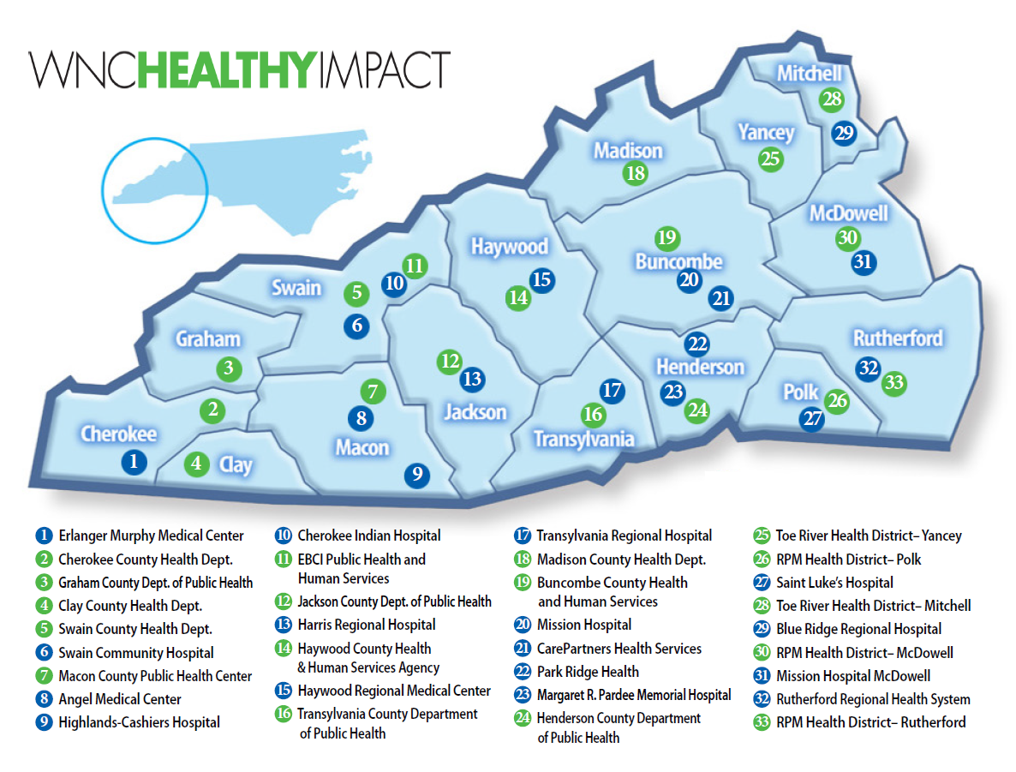

This innovative regional effort is supported by financial and in-kind contributions from hospitals, public health agencies, and partners, and is housed and coordinated by WNC Health Network, Inc.
Current efforts to infuse Results-Based Accountability™ throughout this process are supported by a grant from The Duke Endowment.
Notes:
WNC Healthy Impact is a partnership and coordinated process between hospitals, public health agencies, and key regional partners in western North Carolina working towards a vision of improved community health. ALL OF THESE AGENCIES ARE WNC HEALTHY IMPACT. We are working together locally and regionally to assess health needs, develop collaborative plans, take action, and evaluate progress and impact.
This innovative regional effort is supported by financial and in-kind contributions from hospitals, public health agencies, and partners, and is housed and coordinated by WNC Health Network, Inc. Current efforts to infuse Results-Based Accountability throughout this process are supported by a grant from The Duke Endowment.
This map represents the current partners in WNC Healthy Impact. It takes all of us to accomplish our work together.

Slide 3
Enhances partnerships between hospitals and health departments
Improves efficiency, quality, and standardization of community health assessment data collection and reporting (all reporting)
Encourages strategic investment of community resources to address priority health issues
Impacts health through catalyzing and coordinating action among existing and new assets and initiatives to address priority health needs
Monitors results to improve process, quality, and outcomes
Promotes accountability of hospitals and health departments through meeting community health improvement requirements at state and national level
with a vision of improving health for all of western North Carolina - Coordinated by WNC Health Network, Inc.
Notes:
These are the goals that currently drive our work. They have been tweaked over time as we get more clarity of purpose and destination.

Slide 4


Community Health Improvement Process
Collect & Analyze Community Data
Decide What is Most Important to Act On
Phase 3 Oct. 2019 – Dec. 2020
Phase 1 Jan. 2018 – Mar. 2019
Continuous Action & Ongoing Evaluation
Take Action & Evaluate Health Improvement
Community Health Strategic Planning
Phase 2 Apr. 2019 – Sep. 2019
Notes:
At it’s core, WNC Healthy Impact is about supporting local public health agencies and hospitals to achieve excellence in collaborative community health improvement.
This modified version of the RWJF Take Action Cycle summarizes what we are doing together. This is a continuous improvement cycle – 3 years – that we now support regionally. The first three steps (compile data, analyze and prioritize need) comprise the Community Health (Needs) Assessment.
To improve health across the region, we follow the cyclical 3-year community health improvement process, which is considered national best practice and is required for many agencies for accreditation, including health depts. in NC. It’s required for non-profit hospitals, although it’s considered best practice for all hospitals regardless of tax status.
The first three steps make up the CHA. These are happening in 2018 for all western NC counties. In 2019, action plans will be due. From then until the next cycle, you’re implementing the things in your action plan and seeing if they’re helping, except in reality you’re already doing that all the time and never stop.
Once priorities are set, the cycle moves to creating a community-wide shared action plan, which represents the efforts of local of agencies and individuals. The bulk of the work during the three year cycle is really on this last step, “doing the work and knowing if the it’s making any difference.” So that’s where we’ve shifted most of our support in recent years. We now use RBA to help us do that.
Community health assessment is a systematic examination of the health status indicators for a given population that is used to identify key problems and assets in a community.
The ultimate goal of a community health assessment is to develop strategies to address the community’s health needs and identified issues.

Slide 5
What is a Community Health (Needs) Assessment?
Community health assessment is a systematic examination of the health status indicators for a given population that is used to identify key problems and assets in a community.
The ultimate goal of a community health assessment is to develop strategies to address the community’s health needs and identified issues.
A variety of tools and processes may be used to conduct a community health assessment; the essential ingredients are community engagement and collaborative participation.

Slide 6
WNC Healthy Impact Organizational Chart
WNC Hospital Leaders
WNC Healthy Impact Steering Committee*
(Health Department & Hospital Representatives, Strategic Regional Partners, WNC Health Network)
WNC Health Network
WNC Local Health Directors
WNC Healthy Impact Members (Public Health & Hospital Representatives)
Communications Workgroup*
Data
Workgroup*
Data Consulting Team
Results-Based Accountability Workgroup*
RBA Consulting Team
Community-Level Partners and Stakeholders
*Led and facilitated by WNC Health Network staff
Notes:
To operationalize how we work across the entire region to accomplish those goals, here is our structure:
WNC Healthy Impact is driven by a collaborative steering committee that provides operational support for the initiative and is informed by continuously evolving task-related work groups.
Work group members include staff of hospitals, health departments, and partner agencies across the region.
In addition to local involvement, hospital representatives also serve on the project steering committee and regional workgroups.
The specifics of the work are guided by evidence-based approaches to implementing and communicating change and understanding its impact.
This innovative regional effort is supported by financial and in-kind contributions from hospitals, public health agencies, and partners, and is housed and coordinated by WNC Health Network, Inc., and is funded by the hospital systems in western North Carolina.
Current efforts to infuse Results-Based Accountability throughout this process are supported by a grant from The Duke Endowment.

Slide 7



WNC Healthy Impact Organizational Chart
WNC Healthy Impact Steering Committee
(Health Department & Hospital Representatives, Strategic Regional Partners, WNC Health Network)
Governance, Vision, and Strategy
WNC Healthy Impact Working Groups (Data Workgroup, Communications Workgroup, Results-Based Accountability Workgroup)
Action Planning
WNC Health Network
(Shared Measures)
WNC Healthy Impact Partners (Public Health & Hospital Representatives)
Execution
Community Stakeholders
Public Will
*Adapted from Stanford Social Innovation Review’s Cascading Levels of Collaboration in Collective Impact
Notes:
Here is another way of looking at how WNC Healthy Impact is structured, modeled off of Collective Impact Cascading Levels of Collaboration (https://ssir.org/articles/entry/social_progress_through_collective_impact)
The text in blue is about the “how” of community health improvement, not the “what” – meaning building capacity to set health priorities, not program-level.
Shared measures is aspirational. We’re working on people having shared measures in the region.

Slide 8
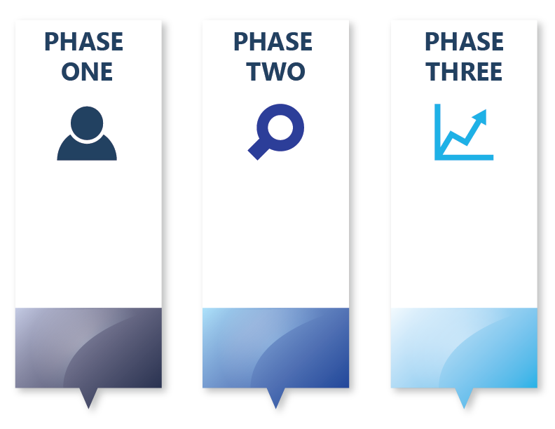
Community Health
Improvement
Timeline:
What Needs to Get Done?
Collect + Analyze Community Health Data
Decide what you need
Make sense of data
Decide What Is Most Important To Act On
Clarify desired conditions of wellbeing for your population
Determine local health priorities
Community Health Strategic Planning
Make a plan with partners about what works to do better
Form workgroups around each strategic area
Clarify customers
Determine performance results and measures
Take Action and Evaluate Health Improvement
Plan how to achieve customer results
Put plan into action
Workgroups continue to meet
Workgroups monitor customer results and make changes to plan
Jan. 2018 – Mar. 2019
Apr. 2019 – Sep. 2019
Oct. 2019 – Dec. 2020
Notes:
Refer to Details and Deliverables document for more detail

Slide 9
Community Health
Improvement
Timeline:
How is WNC Healthy Impact Helping You?
WNCHI Provides:
Training + support for local data collection and analysis
Training + support for prioritization and community strategic planning on health priorities
WNCHI Provides:
Training + support for action planning, hospital implementation strategy development and CHIP
Training + support for performance measure improvement
WNCHI Provides:
Training + support for SOTCH reports
Regional Priority Convenings
Training + support for performance measure identification and improvement
Ongoing Support Provided by WNC Healthy Impact:
Hospital/Public Health support + training provided as requested on RBA basics and specific use of RBA and Scorecard
Convene regional workgroups and continued TA/Coaching for Scorecard and Performance Measures
Peer learning, technical assistance, & coaching
Training + support for performance measure identification and improvement
Jan. 2018 – Mar. 2019
Apr. 2019 – Sep. 2019
Oct. 2019 – Dec. 2020
Notes:
The next few slides summarize the processes and the products that WNC Healthy Impact supports.

Slide 10
Community Health
Improvement
Timeline:
What Products Do You Walk Away With?
Public Health Products
& Reporting:
Community Health Assessment (CHA) Report
Hospital Products
& Reporting:
Community Health Needs Assessment (CHNA) Summary
Public Health Products
& Reporting:
Community Health Improvement Plan (CHIP)
Action Plans (Long Term/ Short Term)
Hospital Products
& Reporting:
Hospital Implementation Strategy
IRS Form 990- Schedule H
Public Health Products
& Reporting:
State of the County Health (SOTCH) Report
Hospital Products
& Reporting:
Hospital Implementation Strategy Update
IRS Form 990 – Schedule H
Jan. 2018 – Mar. 2019
Apr. 2019 – Sep. 2019
Oct. 2019 – Dec. 2020

Slide 11
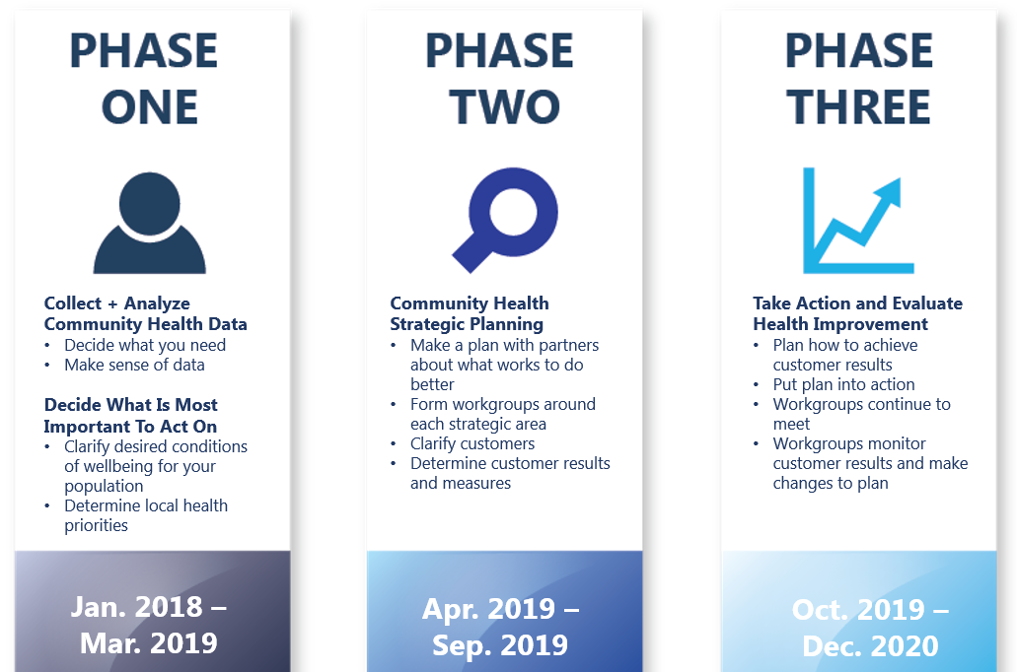
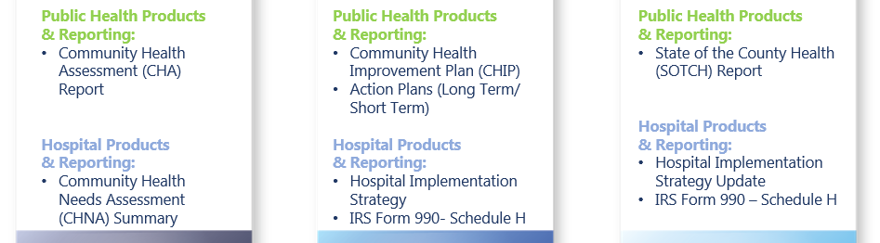
Community Health
Improvement
Timeline:
What Needs to Get Done & What You Walk Away With
What Needs to Get Done
Jan. 2018 – Mar. 2019
Apr. 2019 – Sep. 2019
Oct. 2019 – Dec. 2020
What You Walk Away With

Slide 12
Dataset Strategy (Ingredients)
A comprehensive set of county-level data that reflects health status and factors/determinants.
Secondary data – (data that exists)
Pulled from publicly available sources and compiled into a workbook with all WNC counties and a regional comparison provided.
Primary data – (data that we create)
Regional Community Health Survey
Statistically representative sample of the broader community
“Key Informant” Interview Surveys
Expert opinion and “story behind the data”
Can be supplemented locally (listening sessions, etc.)
Notes:
These are the data-specific ingredients we provide.

Slide 13
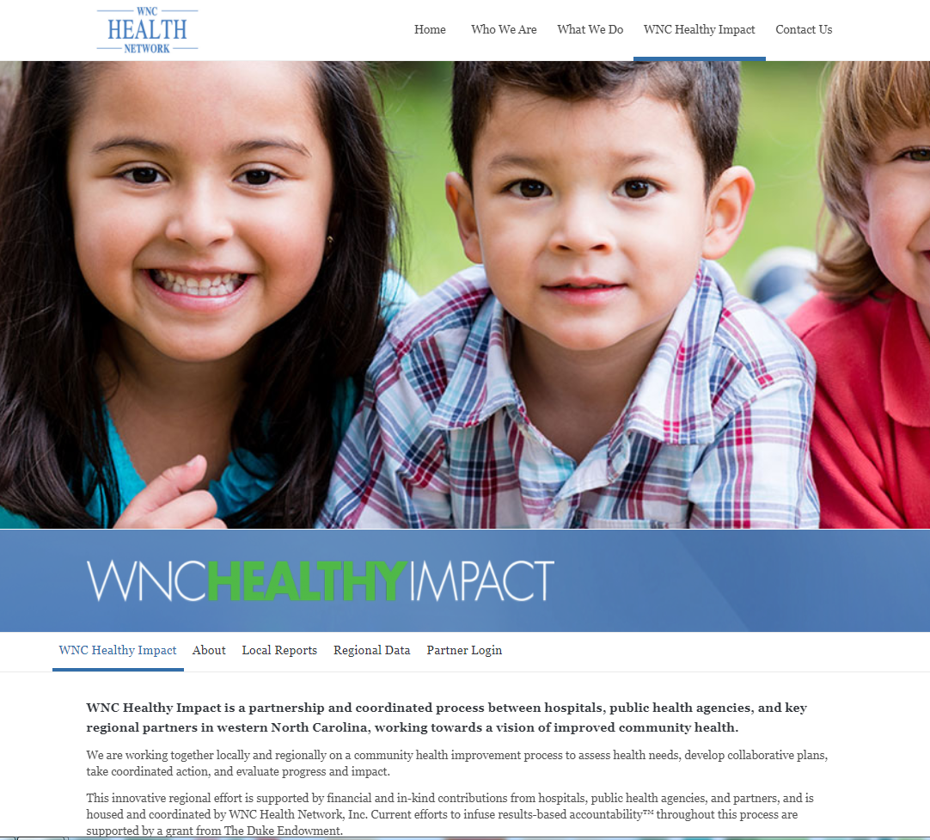
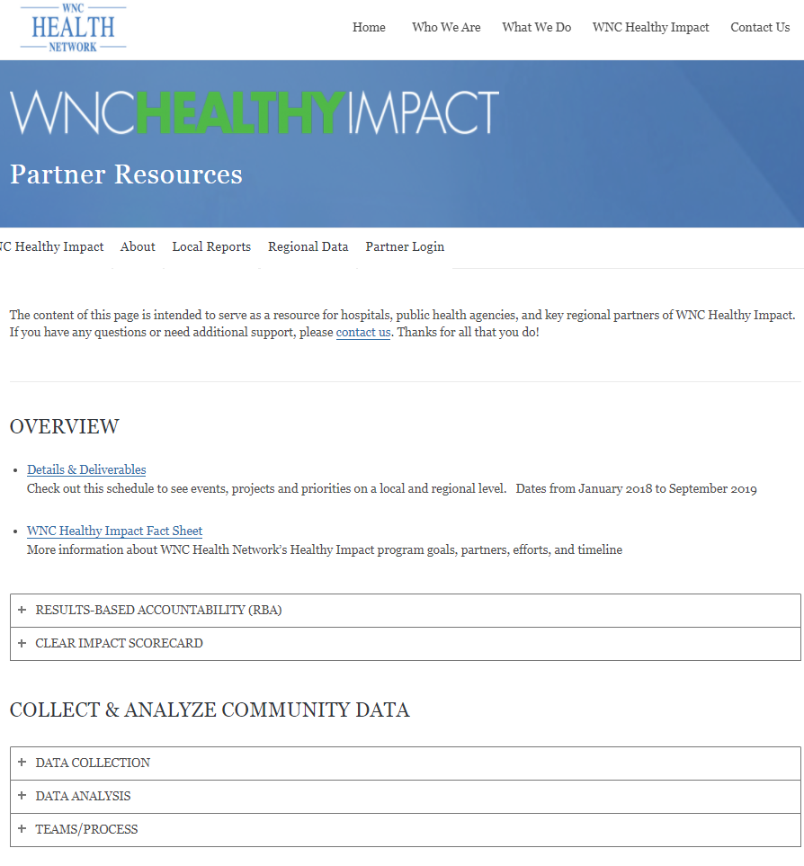
WNC Healthy Impact Webpage
Notes:
This is the current website screen shot
If you need your Partner Log-In, contact WNC Health Network at 828-667-8220

Slide 14
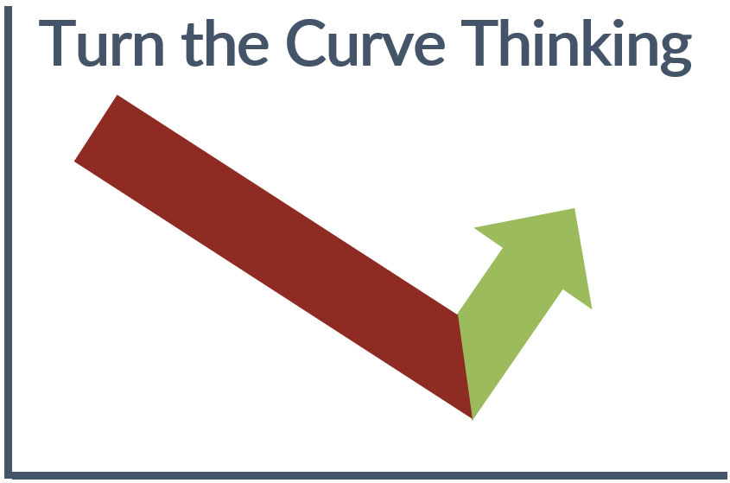
Results-Based AccountabilityTM (RBA)
Uses a data-driven, decision-making process to help communities and organizations get from “talk” to action.
It is a simple, common sense framework that everyone can understand. RBA starts with end in mind.
Operationalizes and measures collective impact.

Slide 15
How are we doing?
Community Health
Improvement
Process
& Turn The
Curve Thinking
Collect & Analyze Community Data
What is the story behind the data?
Decide What is Most Important to Act On
Phase 3
Phase 1
Continuous Action & Ongoing Evaluation
Who are the partners making things better?
Take Action & Evaluate Health Improvement
Community Health Strategic Planning
What are we going to do about it?
Phase 2
What works to do better?

Slide 16
Why is WNC Healthy Impact using RBA?
National focus on cost, quality, population health and measurable results within health and healthcare
Being results-focused and data-driven is best practice, good business, and often a compliance requirement.
We need common language and capacity to clearly show and measure how strategies contribute to the “big priorities” at the population level.
94% of public health leads in WNC Healthy Impact agreed RBA provides an “improvement over the usual way of working.”
Notes:
Current efforts to infuse Results-Based Accountability throughout this process are supported by a grant from The Duke Endowment.

Slide 17
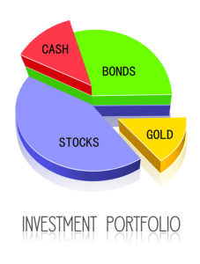

Notes:
You can think of it like your retirement account. You know that the result you want is lots of money. But what investments contribute to get you there? How are each of your stocks performing individually? Are you getting safe long-term options, like bonds, or also experimenting with new options like bit coin?

Slide 18

Building Sidewalks
Diabetes Management Classes
Nutrition Counseling
Access to Healthy Foods
Program/Strategy
Performance Measures
Population Indicator
(e.g. Diabetes Incidence)
Notes:
Population health is the same way. We need to agree on what we value and how to measure it – what result do we have in mind? Then we need to know what mix of strategies (“investments”) we’ll implement to get us there. Are each of them effectively contributing? What is their collective impact?

Slide 19
Getting to Results Training
For more information or to host a custom training specifically for your community, contact: Erin Braasch, (828) 418-5037, erin.braasch@wnchn.org
WNC Health Network hosts “Getting to Results” RBA trainings on a quarterly basis.
This training is free of charge to participants, and lunch is provided.
Who should attend?
Individuals or organizations that partner with their hospital and/or health department to address community health priorities
Health department and hospital representatives involved with community health improvement
Participants will:
Identify 3 types of performance measures
Practice identifying performance measures for your own program, initiative, or agency.
Identify “headline measures” and discuss their value
Plan how to use performance measures to improve performance
Communicate how performance measures contribute to population well-being (i.e. how your work contributes to the overall community health improvement work)

Slide 20
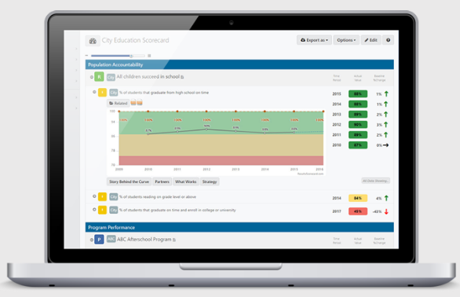
Communication and Accountability
WNC Health Network provides scorecard licenses, templates, training, and ongoing support for the use of Clear Impact Scorecard for community health improvement.
This is a real-time, interactive scorecard to display population and program-level data.

Slide 21
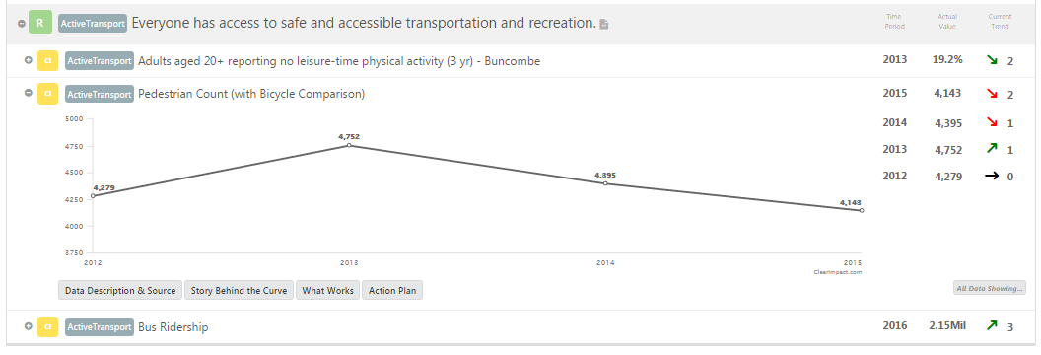
Electronic Community Health Improvement Plans
Easy-to-use, low cost, data tracking and display tool
WNC Health Network staff build templates with guidance
Helps organize community health improvement efforts
Real-time and interactive, easy to connect to & share with partners
100% of public health reps in WNC Healthy Impact agree it’s “an improvement over the usual way of working”

Slide 22
WNC Health Network
WNC Health Network offers skills and connections to support hospitals, health departments, and their partners to create a western North Carolina where residents can thrive and live their healthiest lives.
Included in the core support provided via WNC Healthy Impact for Community Health Assessment:
Secondary dataset core – collection, management, and reporting
Survey data collection and reporting (via the central regional process)
Key informant interview (by email) and reporting
Reporting templates (paper and Scorecard)
Training on data use and prioritization – as part of regional convenings
Coaching and support for local process leaders (public health) and hospital partners
Resource inventories made available via 211
Support hospital/health department partnership and dialogue
Fee-for-service extras that WNC Health Network can provide to support capacity locally:
Support with collection, management, analysis, and reporting of additional local data (not part of the regional data core)
Technical support on facilitation and reporting of focus groups/listening sessions
Data presentations to local partners
RBA training for partner agencies
Local prioritization facilitation
Cross-sector strategic planning facilitation
Final report writing – CHA; CHNA Summary
www.WNCHN.org
Notes:
Core
Training on data use and prioritization – as part of regional convenings
Enhance your quality improvement toolkit for any of your departments by participating in “Getting to Results” Training (next one 7/19, TBD); focus on identifying measures that help move you from volume and quality measures to value measures (is anybody better off?)
Coaching and support for local process leaders (public health) and hospital partners
Where your work interacts and collaborates outside of your agency, we can provide support on “how” you work together, e.g. Erin working with a Transitions of Care team lead by a hospital in the region, but partnering with public health, transportation, CCWNC, and long term care facilities. Provided direct facilitation support for 2 meetings (our limit for free “doing”) that helped the team move from talking about the issues to identifying strategic areas of focus and first steps for action. Ongoing support as a “thought partner” for how to keep momentum going with a group and infusing Results-Based Accountability thinking in meeting agendas, resulting in data-driven, action-oriented groups.
Coaching and support to develop performance measures for hospital-based strategies that contribute to community health improvement, particularly where measures have traditionally been volume and quality-based, we can help you identify value-based performance measures (i.e. is anyone better off?)
Fee-for-Service
Cross-sector strategic planning facilitation, e.g. we have been hired to facilitate community conversation and strategic planning on specific health topics, helping diverse agencies understand each others perspectives on the issue, identify key indicators and service system measures to monitor collectively, identify key strategic directions, select first steps

Slide 23
WNC Healthy Impact Slides for Hospital-Based Stakeholders

Slide 24
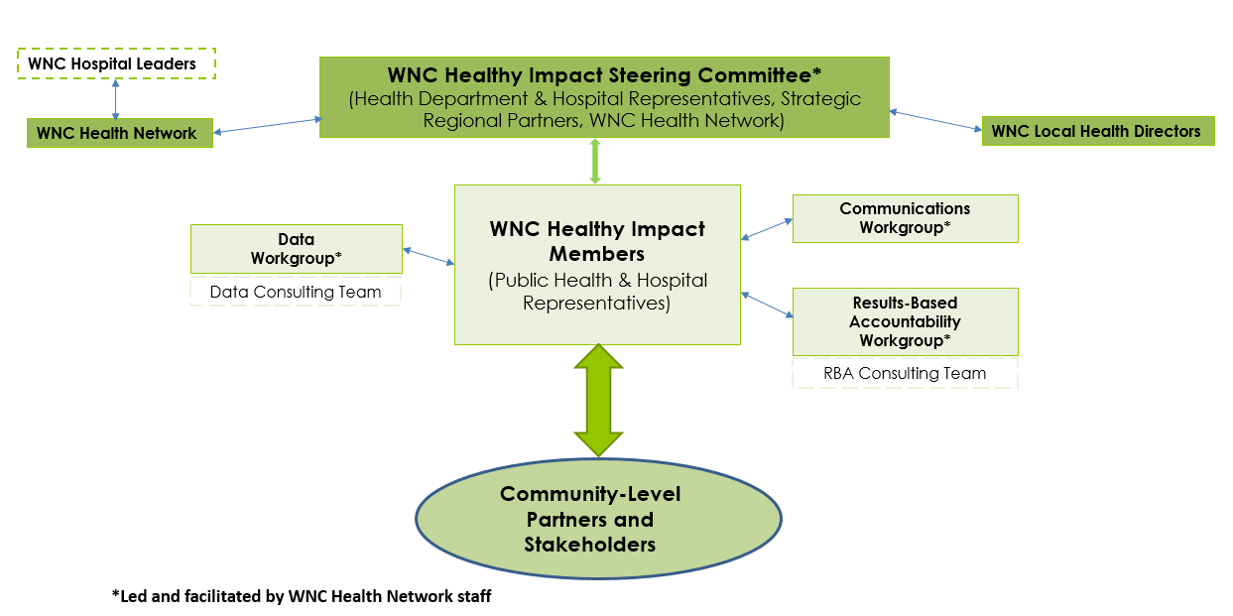
Hospital Involvement in WNC Healthy Impact
Hospitals in western North Carolina contribute financial, leadership, and human resources to implement this project at the regional level.
Each participating hospital facility has designated representatives that support communication and connectivity with WNC Healthy Impact.
These hospital representatives also serve as contacts for collaborative efforts taking place within the hospital’s designated “community.”
Notes:
The WNC Healthy Impact steering committee and task-specific workgroups guide the development of processes, products, and timelines. Some hospitals are involved in these groups as well.

Slide 25
WNC Healthy Impact & CH(N)A Requirements and Reporting
Most hospitals in WNC are required to conduct a community health needs assessment (CHNA), adopt a related facility-specific implementation strategy, and report this work publicly.
To assist participating hospitals with meeting these requirements, WNC Healthy Impact creates and provides multiple datasets, training, templates, technical assistance, and helps facilitate collaboration with local health departments at the regional and local levels.
Each hospital facility is responsible for ensuring that their process and products meets their system and/or facility-specific needs and requirements.

Slide 26
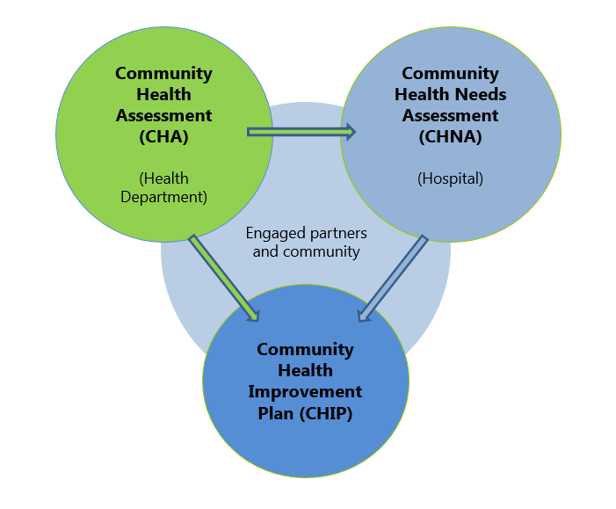
Hospital CHNA Summary & Health Department Community Health Assessment (CHA)
WNC Healthy Impact supports a collaborative community health (needs) assessment process in which hospitals and public health agencies partner to create shared processes and products.
WNC Healthy Impact created a CHNA Summary Template that can be completed and used as “wrapping paper” around one or more community health assessments (CHAs) to help communicate hospital connectivity and clarify requirement elements.
Notes:
Most of the data and findings will be reflected in county-level CHAs.
One important piece of the CHNA Summary that is not reflected in a county-level CHA is an evaluation of the impact of any actions that were taken after the hospital facility finished conducting its preceding CHNA.

Slide 27
Community Health Improvement Plan (CHIP) & Implementation Strategies for Hospitals
A Community Health Improvement Plan (CHIP) serves as a strategic health improvement plan that is designed to reflect the big picture of what is taking place across the whole community related to priority health needs. This plan results from a collaborative action planning process in each county/community and helps encourage cross-sector collaboration.
Hospitals create an Implementation Strategy that describes the hospital-specific response to the community’s identified health priorities.
WNC Healthy Impact creates a template for reporting Hospital Implementation Strategy. This document is designed with the hospital compliance requirements in mind.
Notes:
Where and when hospitals are engaged with a county’s community health improvement process, hospital strategies will be reflected in the CHIP.
It may include hospital-specific strategies in more than one county that makes up their “community” and becomes a public document.
WNC Health Network can provide coaching and technical assistance for the development of your HIA.

Slide 28
WNC Healthy Impact Resources to Help Support Hospital Reporting
A core set of health-related data and reports are available at http://www.wnchealthyimpact.com/resources
Completed community health assessment (CHA) reports and action plans, by county, are available at http://www.wnchealthyimpact.com/local-stories
Many resources for hospitals are available on our partner resource page at http://www.wnchealthyimpact.com/partner-resources. This page is password protected; please contact WNC Healthy Impact for password.
Notes:
CHNA Hospital Summary Template – designed for use by hospitals (Word)
Hospital CHNA Board Presentation Template (PowerPoint)
Hospital implementation strategy template (Word) – in November 2016 it will also be available via Scorecard (electronic, web-based)
Technical assistance and coaching on hospital implementation strategy development
Recorded webinar offering guidance on products and tools
Fact Sheets and other communication tools (PDF)
List of resources with requirements and recommendations for 501c3 hospitals

Slide 29
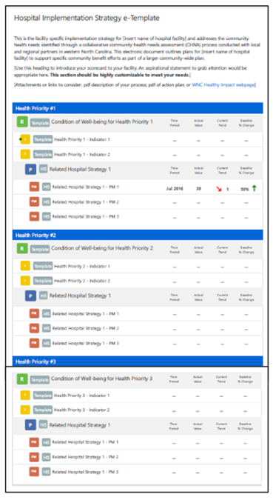
Results-Based Accountability (RBA)
With support from The Duke Endowment, WNC Health Impact is infusing Results-Based Accountability throughout regional trainings, tools, templates and technical assistance. An RBA consulting team is in place to help hospitals, public health agencies, and their aligned partners, use the RBA approach and tools.
Notes:
Results-Based Accountability (RBA):
Provides a common language and a common sense approach that improves the way we talk about what we do and helps us work toward collaborative action with a focus on results.
Is being used throughout the collaborative action and performance measurement (evaluation) processes, tools, and support.
Can be used to help select measures to support annual and next CHNA hospital reporting, as well as ongoing program improvement.
Scorecards for CHIP, Workgroups, and Hospital Implementation Strategy:
Offer an electronic, web-based template as an enhancement and a new approach to monitoring and communication health improvements.
Use Clear Impact Scorecard software, which is low-cost, easy to use, and improves the ability to save and share real-time information with staff, community members, partners, leaders, and funders.
Make it easier to communicate Hospital Implementation Strategy alignment with county-wide efforts to address priority health needs.

