Slide 1
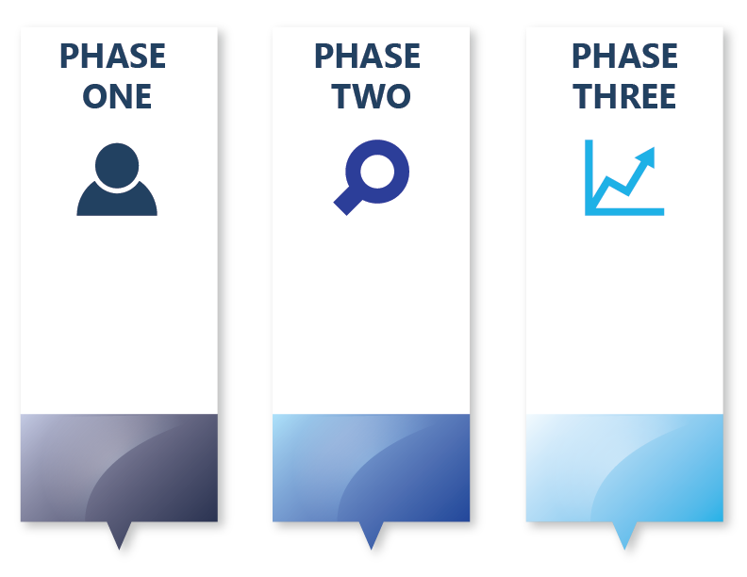
Community Health
Improvement
Timeline:
What Needs to Get Done?
Collect + Analyze Community Health Data
Decide what you need
Make sense of data
Decide What Is Most Important To Act On
Clarify desired conditions of wellbeing for your population
Determine local health priorities
Community Health Strategic Planning
Make a plan with partners about what works to do better
Form workgroups around each strategic area
Clarify customers
Determine performance results and measures
Take Action and Evaluate Health Improvement
Plan how to achieve customer results
Put plan into action
Workgroups continue to meet
Workgroups monitor customer results and make changes to plan
Jan. 2018 – Mar. 2019
Apr. 2019 – Sep. 2019
Oct. 2019 – Dec. 2020

Slide 2
Community Health
Improvement
Timeline:
How is WNC Healthy Impact Helping You?
WNCHI Provides:
Training + support for local data collection and analysis
Training + support for prioritization and community strategic planning on health priorities
WNCHI Provides:
Training + support for action planning, hospital implementation strategy development and CHIP
Training + support for performance measure improvement
WNCHI Provides:
Training + support for SOTCH reports
Regional Priority Convenings
Training + support for performance measure identification and improvement
Ongoing Support Provided by WNC Healthy Impact:
Hospital/Public Health support + training provided as requested on RBA basics and specific use of RBA and Scorecard
Convene regional workgroups and continued TA/Coaching for Scorecard and Performance Measures
Peer learning, technical assistance, & coaching
Training + support for performance measure identification and improvement
Jan. 2018 – Mar. 2019
Apr. 2019 – Sep. 2019
Oct. 2019 – Dec. 2020

Slide 3
Community Health
Improvement
Timeline:
What Products Do You Walk Away With?
Public Health Products
& Reporting:
Community Health Assessment (CHA) Report
Hospital Products
& Reporting:
Community Health Needs Assessment (CHNA) Summary
Public Health Products
& Reporting:
Community Health Improvement Plan (CHIP)
Action Plans (Long Term/ Short Term)
Hospital Products
& Reporting:
Hospital Implementation Strategy
IRS Form 990- Schedule H
Public Health Products
& Reporting:
State of the County Health (SOTCH) Report
Hospital Products
& Reporting:
Hospital Implementation Strategy Update
IRS Form 990 – Schedule H
Jan. 2018 – Mar. 2019
Apr. 2019 – Sep. 2019
Oct. 2019 – Dec. 2020

Slide 4
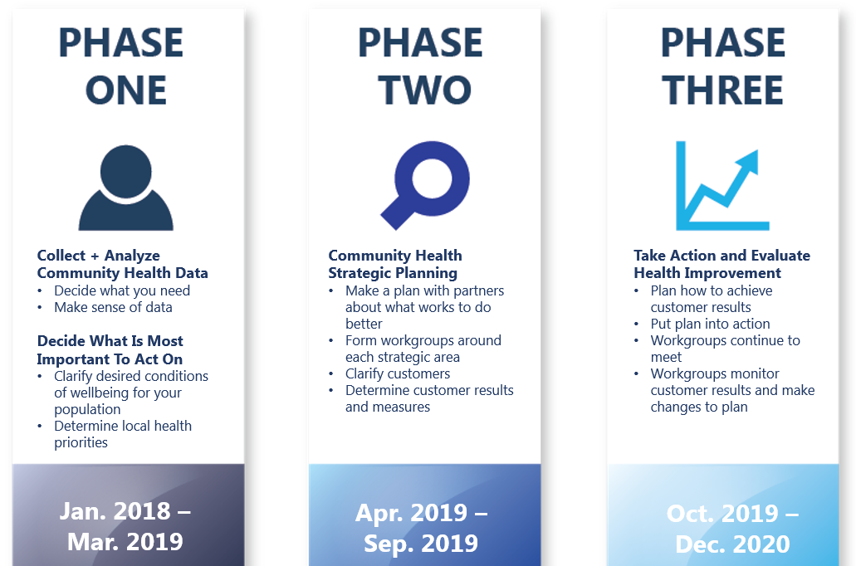
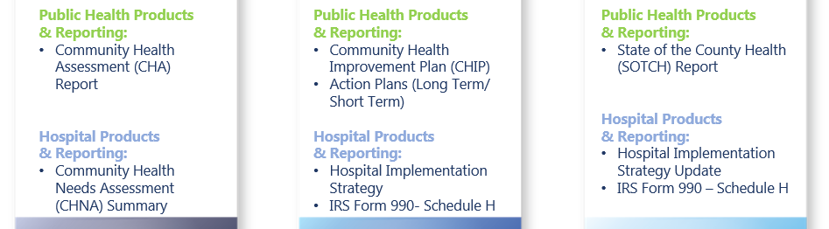
Community Health
Improvement
Timeline:
What Needs to Get Done & What You Walk Away With
What Needs to Get Done
Jan. 2018 – Mar. 2019
Apr. 2019 – Sep. 2019
Oct. 2019 – Dec. 2020
What You Walk Away With

